Slide 1
Categorical Analysis of Loyola Ramblers Games (2016 - present), version 2.0
Charles Hwang (LUC ’20)

Slide 2
Background/Motivations
Uniqueness
only one previous known statistical analysis on these data had been performed
personal interest
Existing dataset
More time for questions

Slide 3
Criteria for Dataset inclusion
All matches between August 19, 2016 and September 12, 2022
Loyola Ramblers’ programs playing “head-to-head” competition include women’s softball (SB) and both women’s and men’s soccer (WSOC, MSOC), volleyball (WVB, MVB), and basketball (WBB, MBB)
Women’s and men’s Cross country, track & field, golf, and spirit teams excluded

Slide 4
Variables included
Team
Season
Type (regular season, conference Tournament, postseason, etc.)
Location (home, away, or neutral)
Opponent
Opponent conference
Outcome (win, draw, or loss)
Day of week
Month
Score for
Score against
Length (regulation vs. overtime, etc.)
Outcome of previous game
Win/loss streak prior to game
Whether or not I attended

Slide 5
Exploratory Data Analysis (EDA)
All data were compiled manually in excel then read into R as a .csv file
n = 1,203 games
Variables selected from those easily available online¹
Conference at time of game recorded^{2, 3}
different conferences per sport²
Accuracy checks
missing data (none)
impossible values
similar values (Northern Iowa vs. Northern Illinois, MVC vs. MAC, etc.)

Slide 6
Hypotheses/Research Questions
Which variable(s) are the most significant for each team?
Did each team perform differently during the seasons before, after, and the successive season after the onset of the COVID-19 pandemic?
Did teams perform differently before and after a head coaching change?
WVB (after 2017), SB (after 2019), MBB (after 2020-21)
Do teams perform differently at home than away/Neutral?
Do teams perform differently when I attend?

Slide 7
Predictions
Location is significant
Season and win/loss streak may be significant
Teams generally performed differently in each of the three seasons
WVB did better, SB and MBB had no statistically significant difference
Teams perform better at home than away
Teams perform better when I attend

Slide 8
Analyses performed
1. GLM (stepwise selection with AIC, both directions)
2-3. (a lot of) Two-proportion z-tests (α = 0.05)
4-5. χ²-tests of independence (α = 0.01)
5. likelihood ratio χ² G-test, Fisher’s exact test

Slide 9
(No MSOC or WSOC) | Season | Type | Location | Month | Match Length | Previous Outcome | Win/loss streak # | Did I attend? | Steps
WVB | ’17, (2) |  | Home, N |  |  |  |  |  | 8
WVB* |  |  |  |  |  |  | 0.023603 |  | 8
WBB | (5) |  |  |  |  |  | 0.080987 |  | 7
WBB* |  |  | Home, N |  |  | 0.008321 |  |  | 6
MBB | (3) |  | Home, N |  |  |  |  | 0.084409 | 8
MBB* |  |  | Home, N |  |  |  | 0.121238 |  | 8
MVB | (0) | Regular |  |  | 4, 5 sets |  |  | 0.055525 | 5
SoftBall |  |  | Home, N | 0.017802 |  |  |  |  | 9
*Without season variable Score was excluded from all, opponent and conference were excluded from some

Slide 10
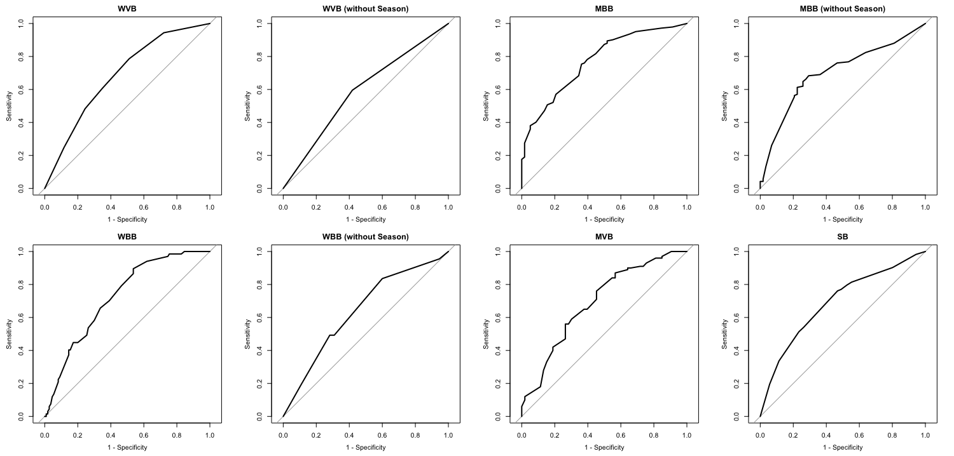
0.7044
0.5836
0.7714
0.7020
0.7248
0.6392
0.6924
0.6878

Slide 11
2. Two-proportion z-tests on win % (years 0, 1, and 2 of pandemic)
*1+ WBB, 9+ MVB, 31+ SB games cancelled in 2020
 | WSOC | MSOC | WVB | WBB* | MBB | MVB* | SB*
0 vs. 1 | 0.77139 | 0.72546 | 0.44357 | 0.58592 | 0.09625 | 0.04106 | 0.04518
0 vs. 2 | 0.96522 | 0.82825 | 0.92523 | 0.52211 | 0.36922 | 0.06620 | 0.10618
1 vs. 2 | 0.78945 | 0.87174 | 0.37403 | 0.24023 | 0.42010 | 0.72402 | 0.60318

Slide 12
3. Two-proportion z-tests on win % (before & After HC change✝)
*χ²(1) = z²
✝No games for men’s soccer, women’s basketball, or men’s volleyball
 | X-statistic* | p-value | Win % before | Win % after | 95% C.I.
WVB (2017) | 14.87044 | 0.0001151535 | 0.3114754 | 0.6129032 | (-0.446,-0.157)
SB (2019) | 3.043565 | 0.08105772 | 0.4901961 | 0.3818182 | (-0.013, 0.229)
MBB (2021) | 0.4344527 | 0.5098121 | 0.7005988 | 0.7575758 | (-0.219, 0.105)

Slide 13
4-5. Two-way frequency tables
 | Home | Neutral¹ | Away
Win | 340 | 103 | 208
Draw | 10 | 0 | 13
Loss | 180 | 79 | 270
Total | 530 | 182 | 491
Win % | 0.65094 | 0.56593 | 0.43686
 | Yes | No | Total
Win | 99 | 552 | 651
Draw² | 2 | 21 | 23
Loss | 44 | 485 | 529
Total | 145 | 1,058 | 1,203
Win % | 0.6897 | 0.5317 | 0.5507

Slide 14
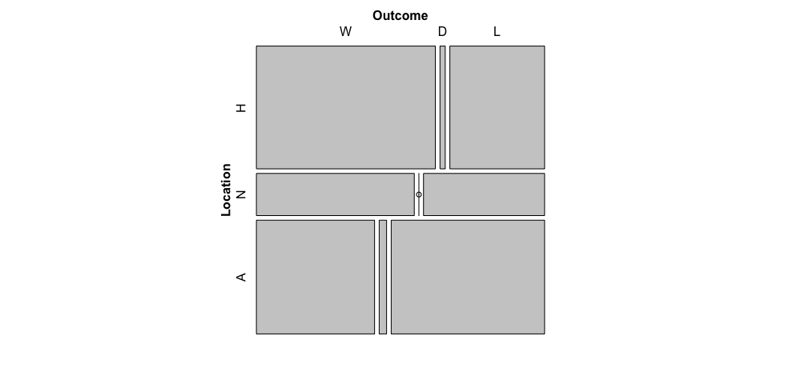
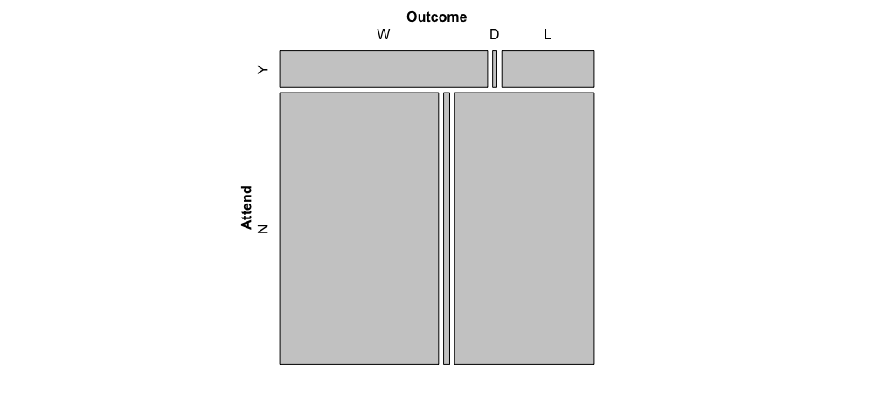

Slide 15
4-5. Two-way frequency tables (modified)
Odds ratio: (99*485)/(573*46) ≈ 1.82164808
 | Home | N+Away¹
Win | 340 | 311
Draw | 10 | 13
Loss | 180 | 349
Total | 530 | 673
Win % | 0.65094 | 0.47177
 | Yes | No | Total
Win² | 99 | 573 | 672
Loss² | 46 | 485 | 531
Total | 145 | 1,058 | 1,203
Win % | 0.6828 | 0.5416 | 0.5586

Slide 16
4-5. χ²-tests of independence, LR χ² G-test, Fisher’s exact test
¹Neutral and away games grouped together
²Attended draws counted as losses, non-attended draws counted as wins
 | Outcome vs. Location | Outcome vs. Location¹ | Location (LR χ² G-test¹) | Outcome vs. Attendance | Outcome vs. Attendance² | Attendance² (Fisher’s)
statistic | 53.11884 | 39.22969 | 39.59474 | 13.31843 | 10.3073
p-value | < 0.0000001 | 0.000000006 | 0.000000003 | 0.001282152 | 0.001325053 | 0.001299138
Signif. code | *** | *** | *** | ** | ** | **

Slide 17
Conclusions
Location is the most significant variable overall (see #4) ✓
Season is also significant
Most teams did not perform differently before and after the pandemic ✗
Exceptions: MVB (p = 0.04106) and SB (p = 0.04518), 2020 vs. 2021
WVB did better, MBB had no difference, SB did worse (not significant) ✓
Teams did better at home (p < 0.00000001) ✓
Teams did better when I attended (p = 0.001310144) ✓

Slide 18
Analysis
see #4, performance between seasons being different also makes sense
Other variables (previous match, match length, month) being statistically significant for individual programs is interesting
This is interesting because I expected training restrictions, strength & conditioning, match conditions (e.g., no fans), etc. to be different, but it makes sense that they are not statistically significant at α = 0.05
This was expected as I followed all the teams before and after
Softball getting “worse” could be attributed to non-con scheduling
This makes sense, most teams perform better at home

Slide 19

Analysis
5.

Slide 20
Randomness and independence assumptions
my attendance of matches was not random
Intuitively, fans attend matches if they want to
Likelihood of attendance may be dependent on past attendance, gameday promotions/giveaways, distance, etc.
Team performance is likely not independent
Performance in a given match may depend on previous matches
However, it appears these assumptions are not “badly” violated.

Slide 21
Improvements made
Further analysis on the underlying reasons for results ✓
Reviewing test assumptions (randomness, independence, etc.) ✓
Updating dataset and results with new data

Slide 22
Future improvements
Adding other variables and interaction terms
Private vs. public, days since previous game, date, time, duration, “official” attendance, national poll rankings, distance from campus, distance travelled, ticket price, whether there was a promotion/giveaway, etc.
Tests on non-conference and conference records instead of overall record
Adding non-head-to-head teams (with final ranking/position as outcome)
Researching how to code draws in Glm for soccer
Predictive analytics (CART, random forest, etc.), machine learning
Time-series analysis

Slide 23
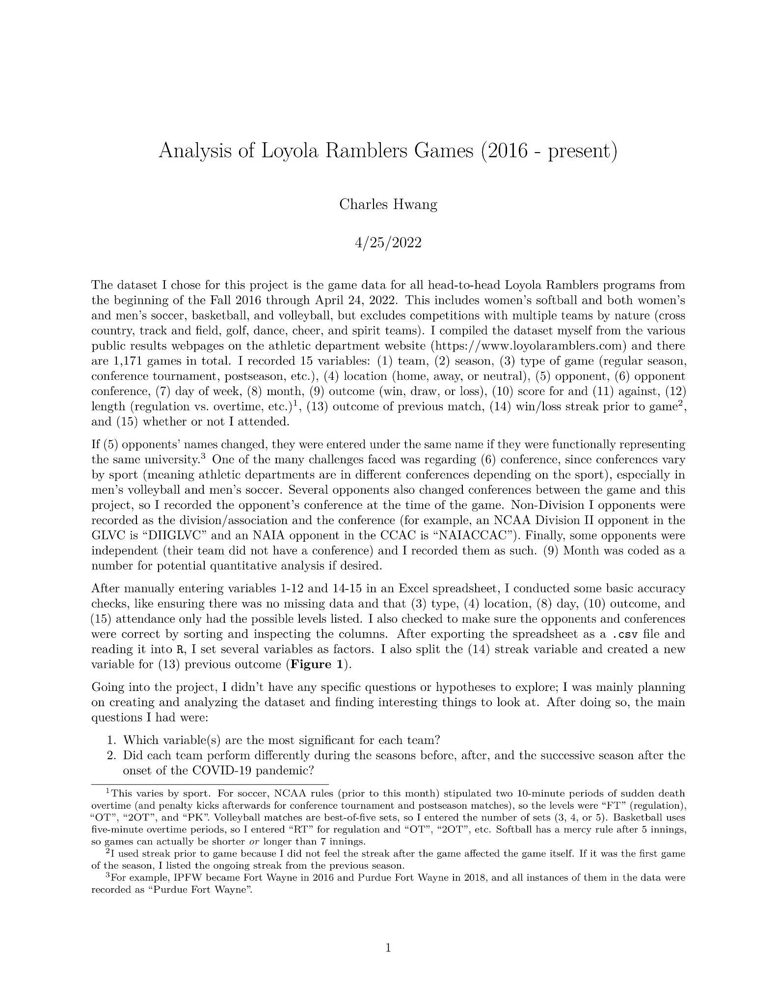
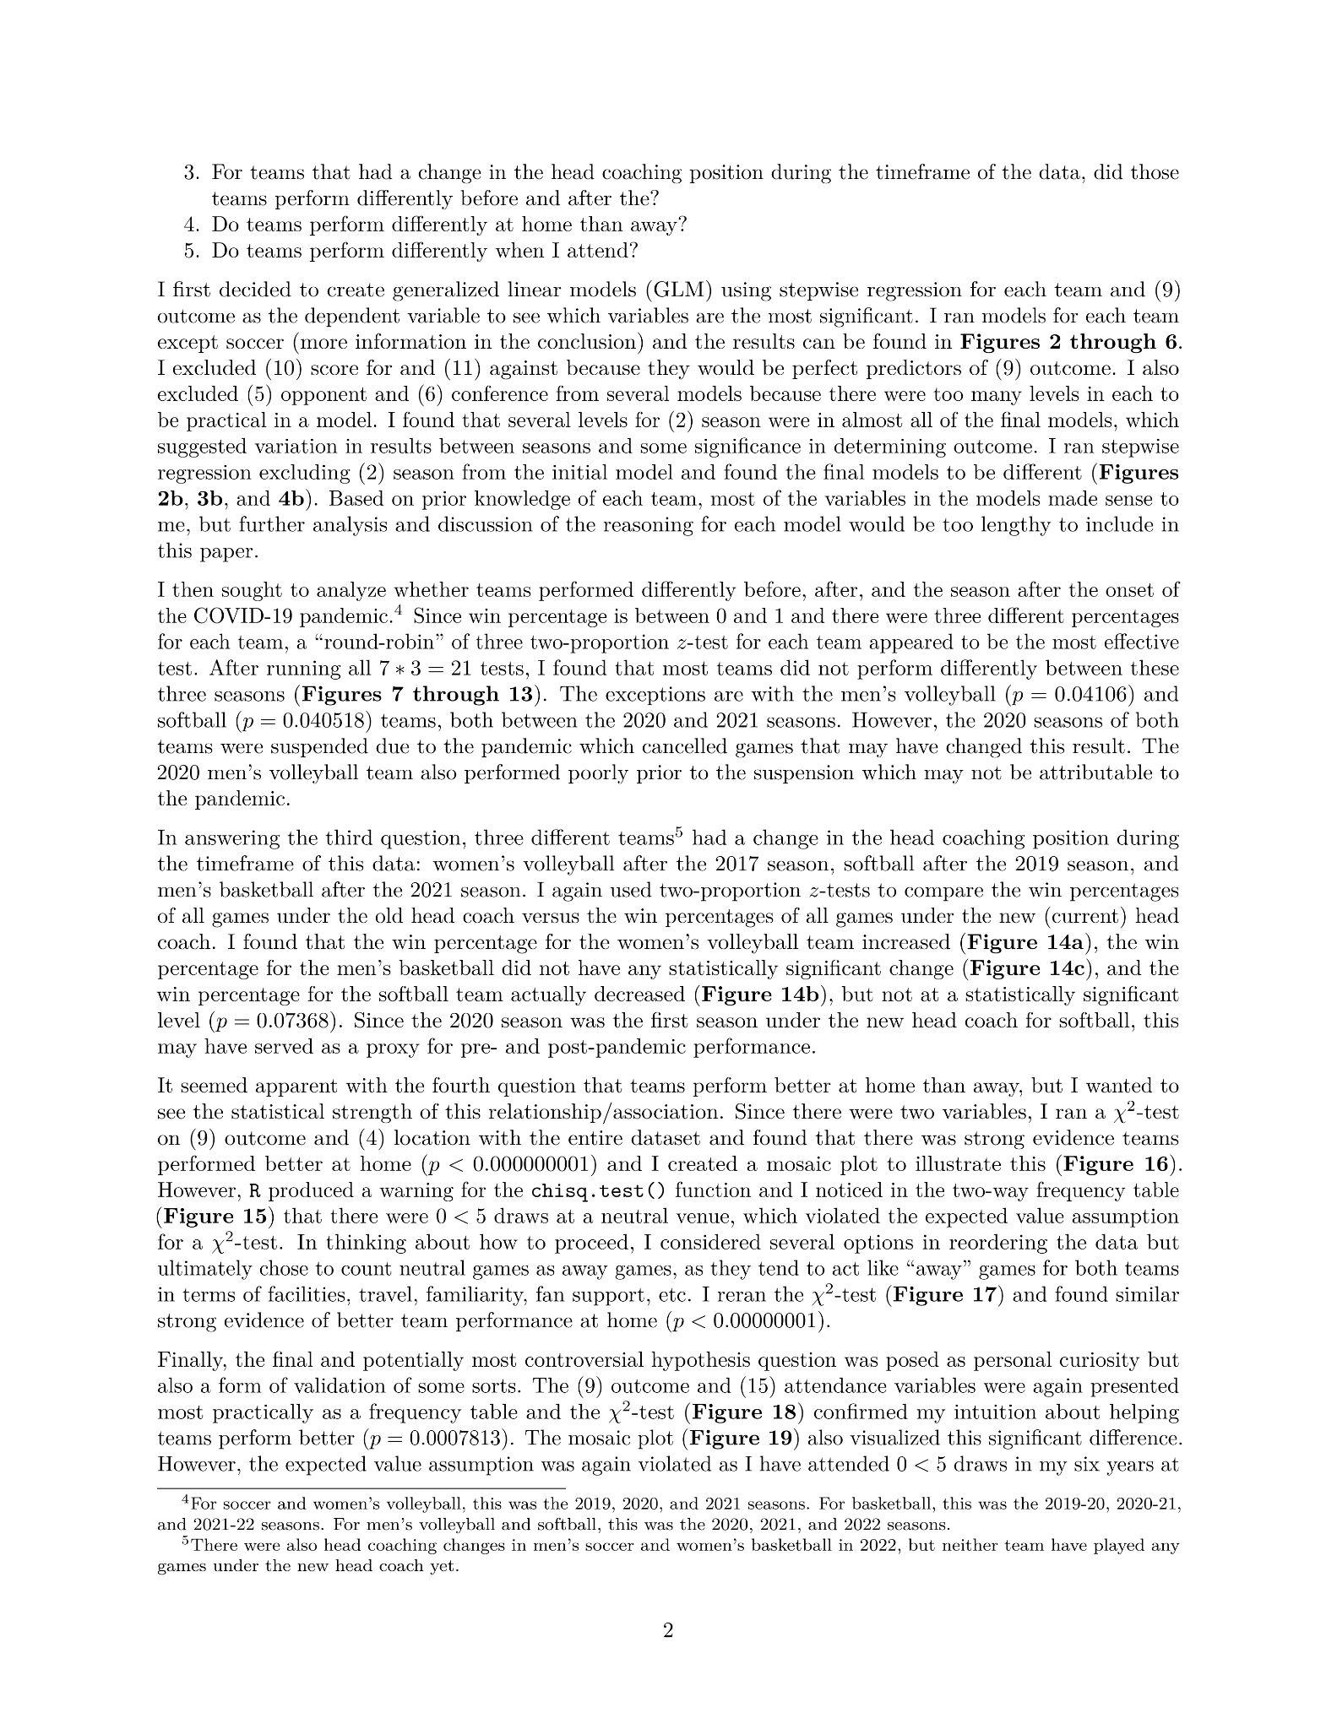
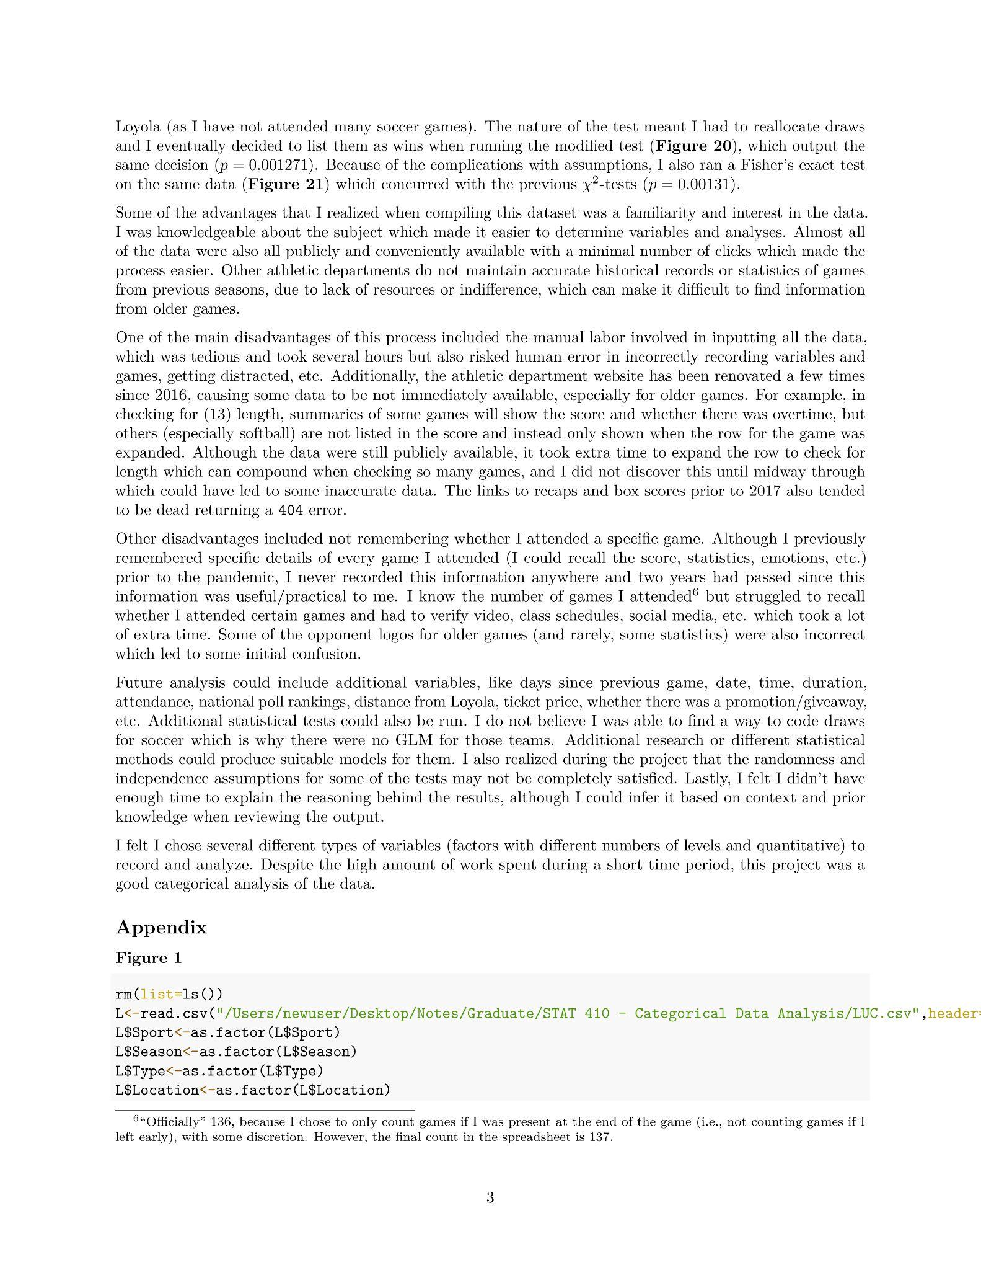
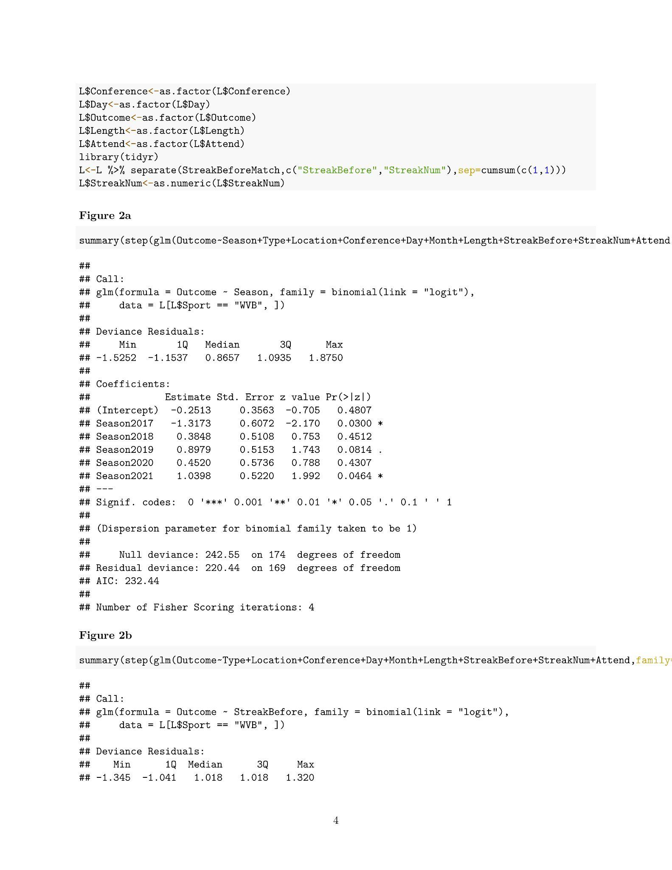
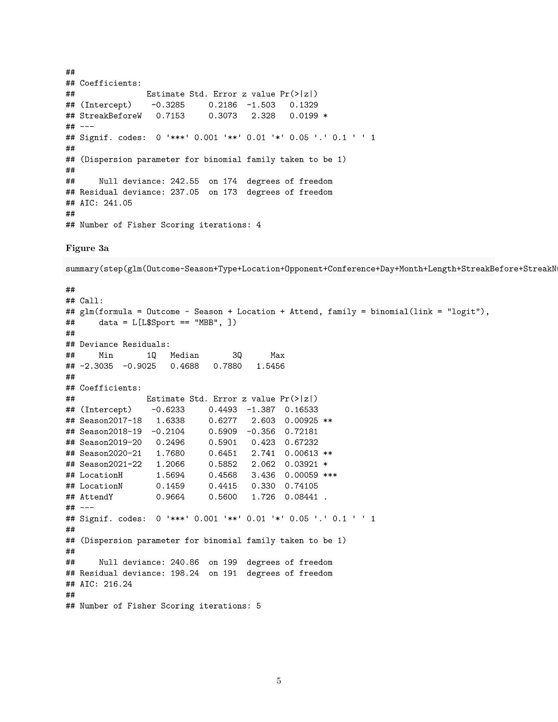
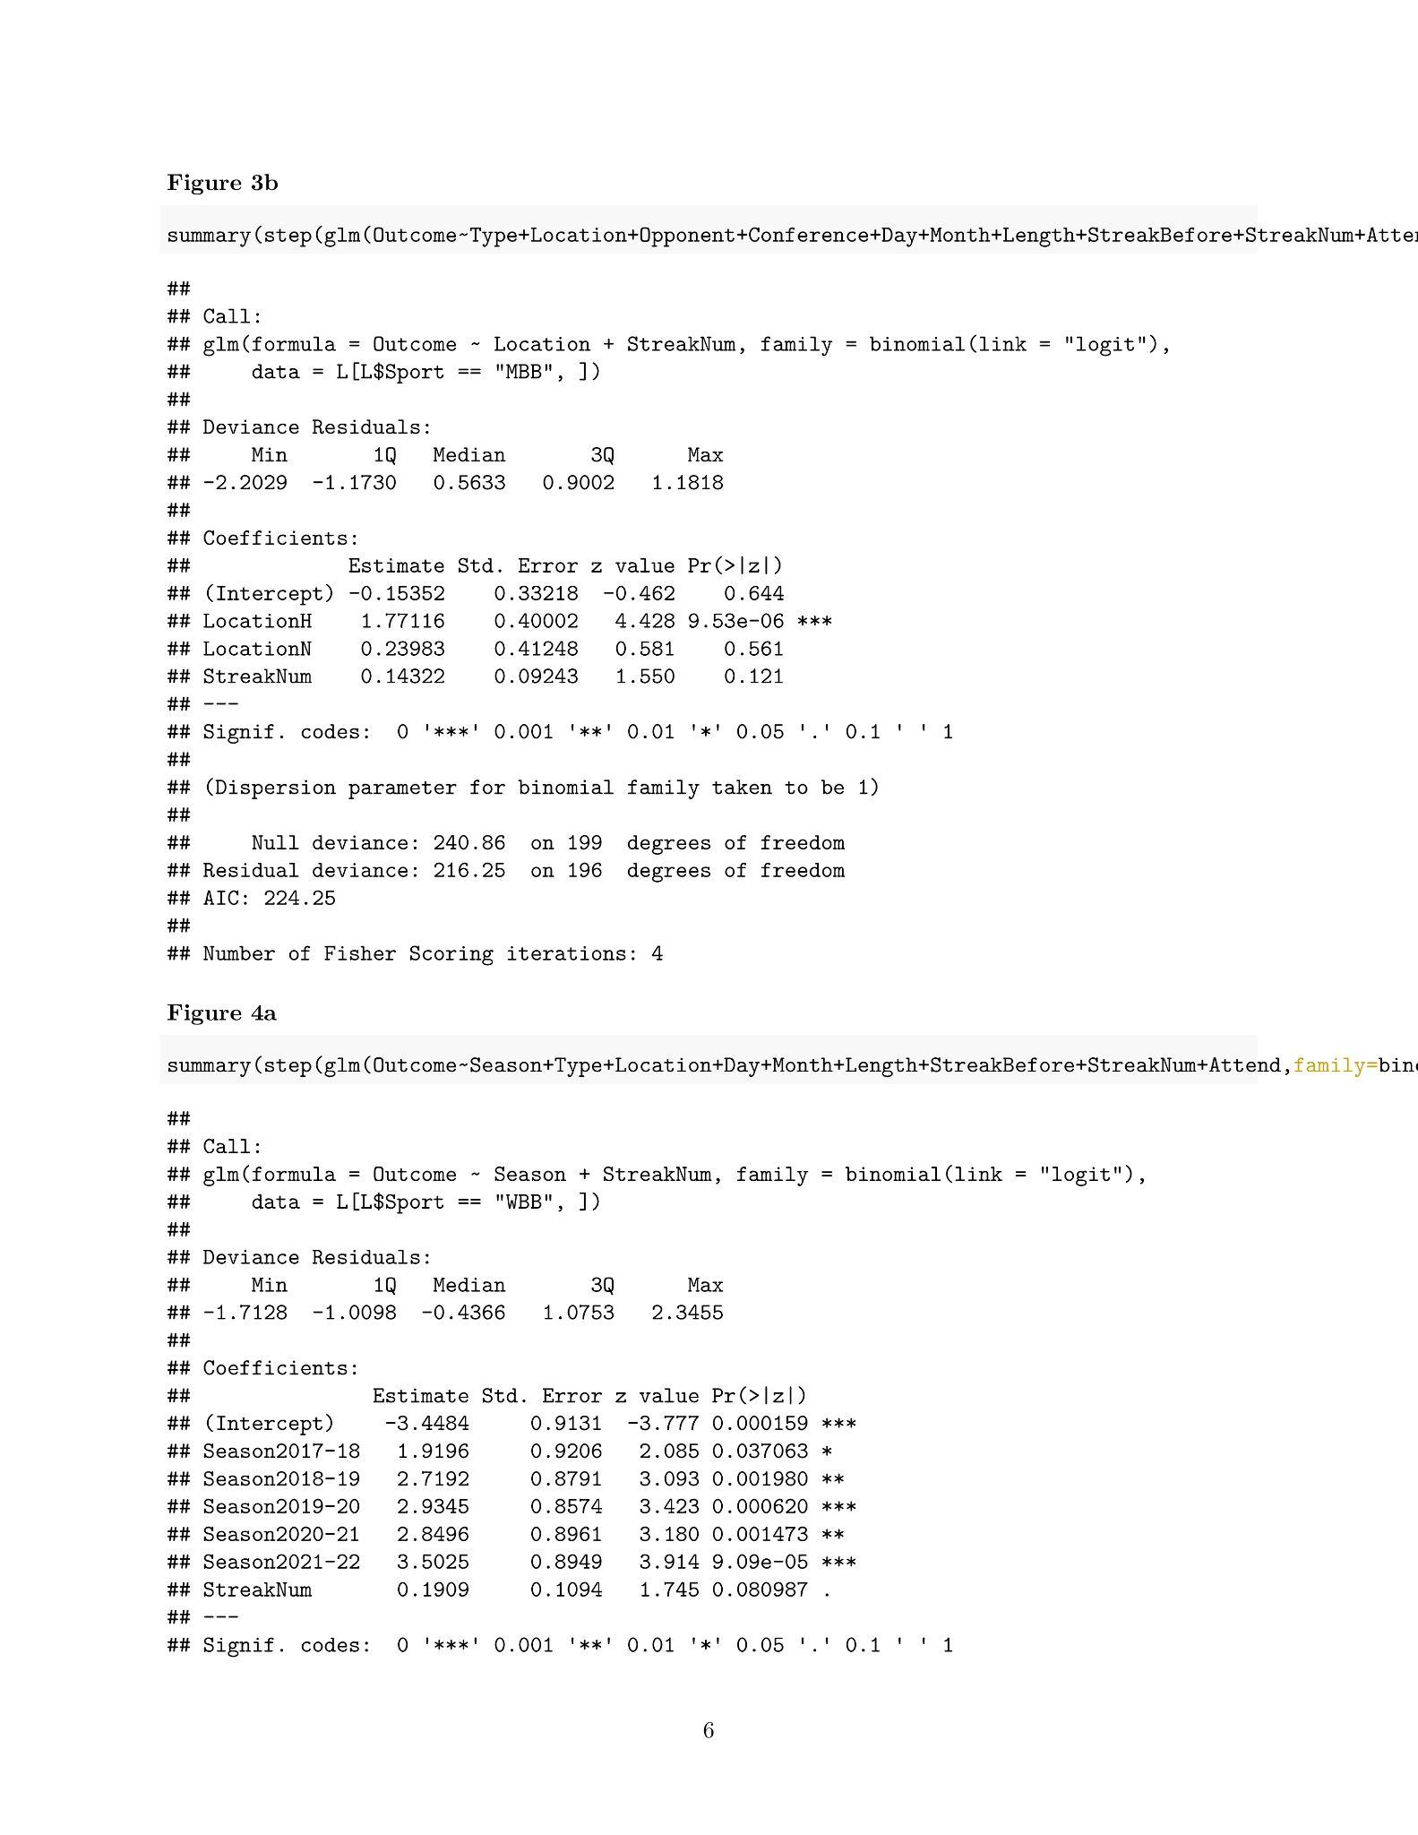
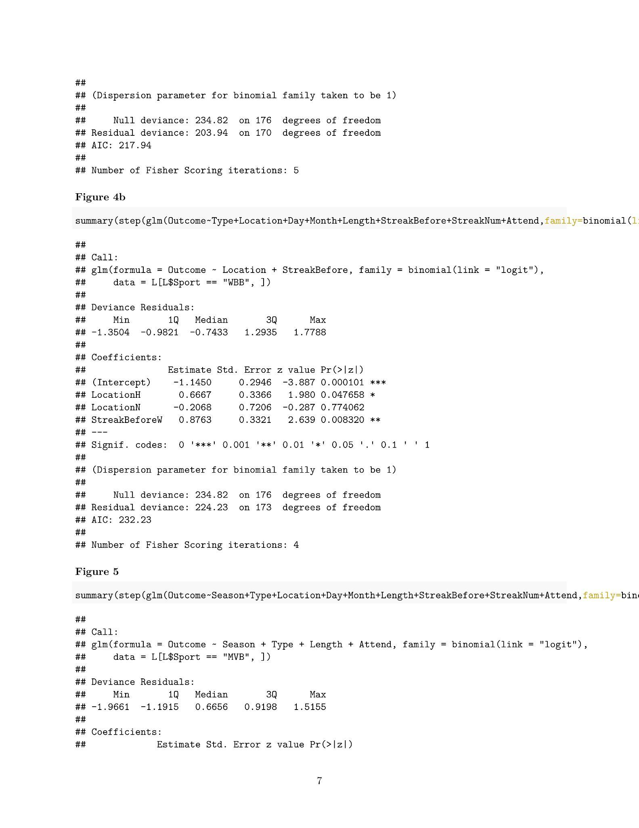
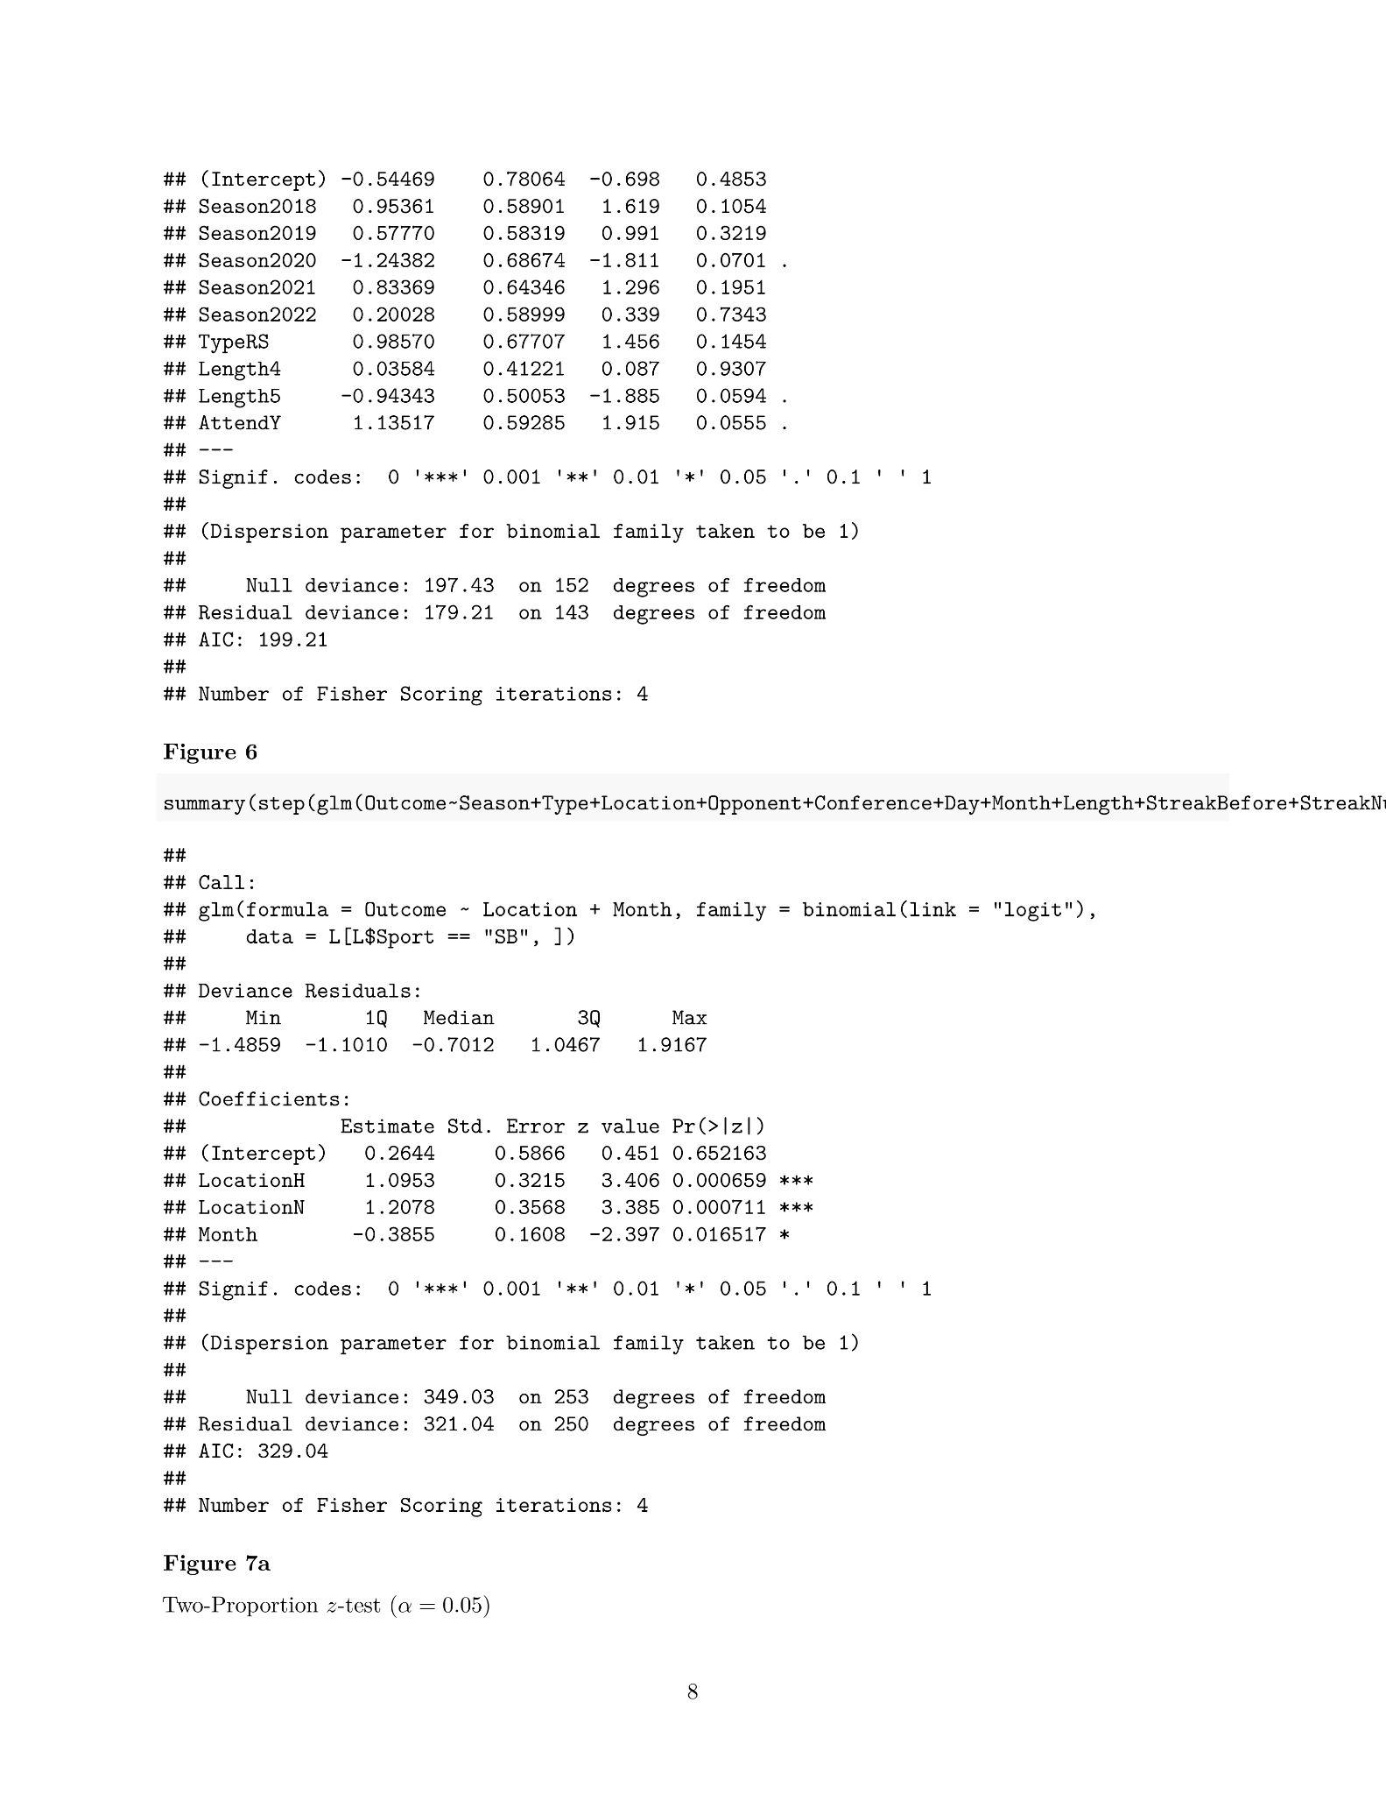
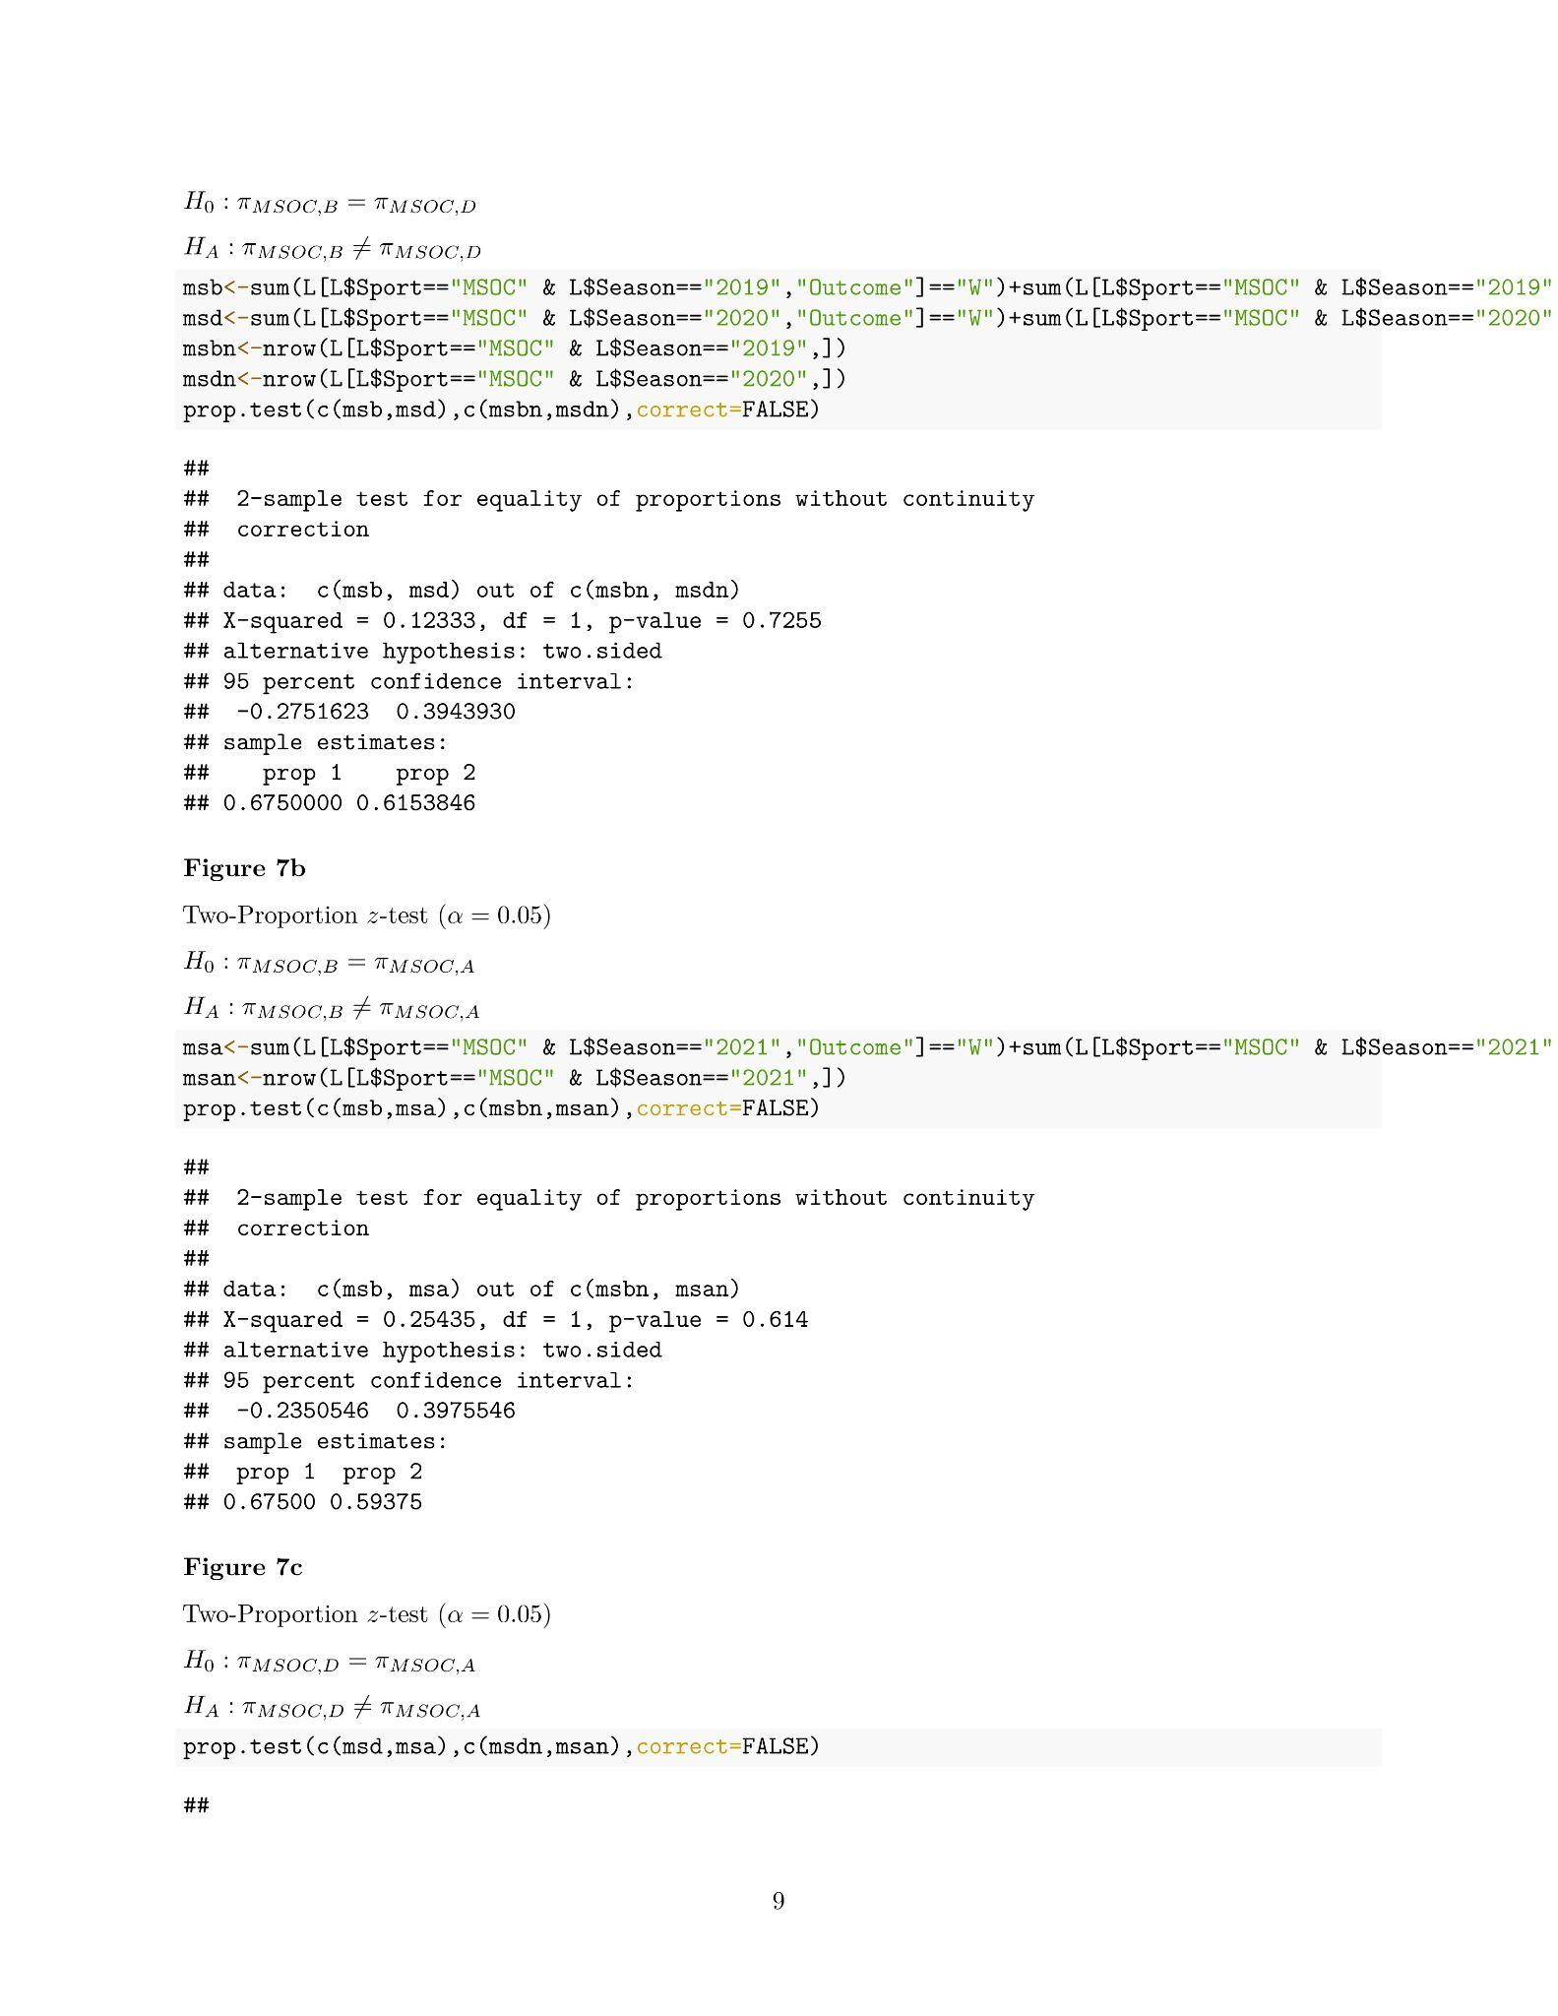
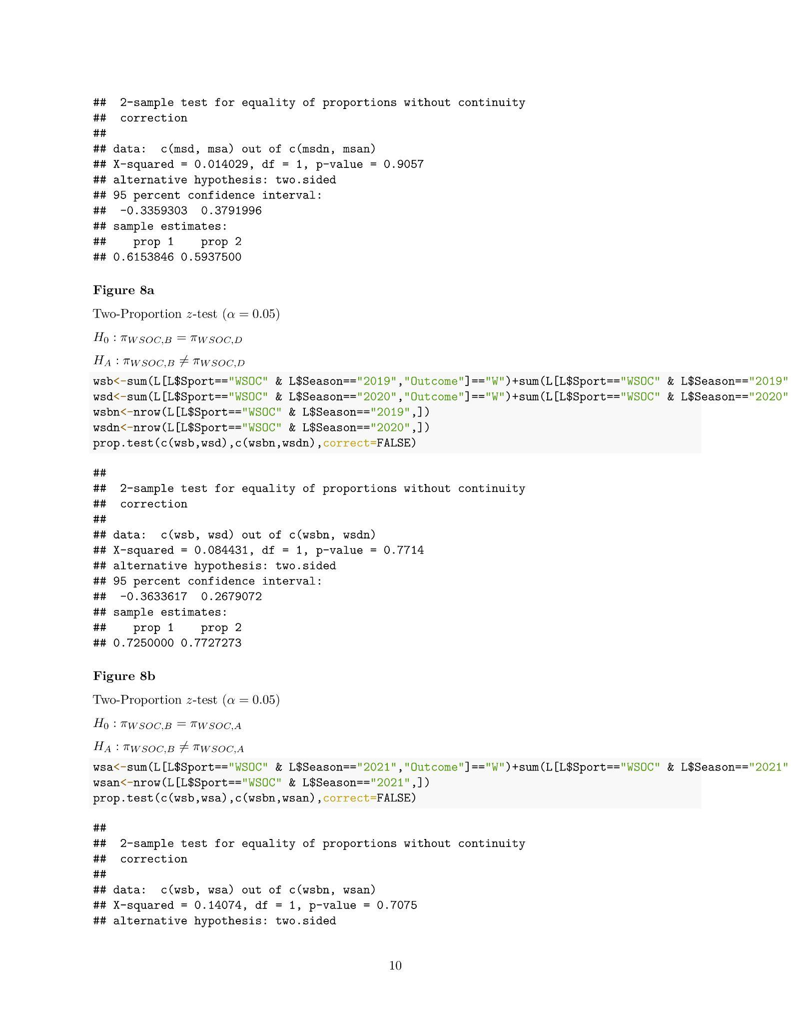
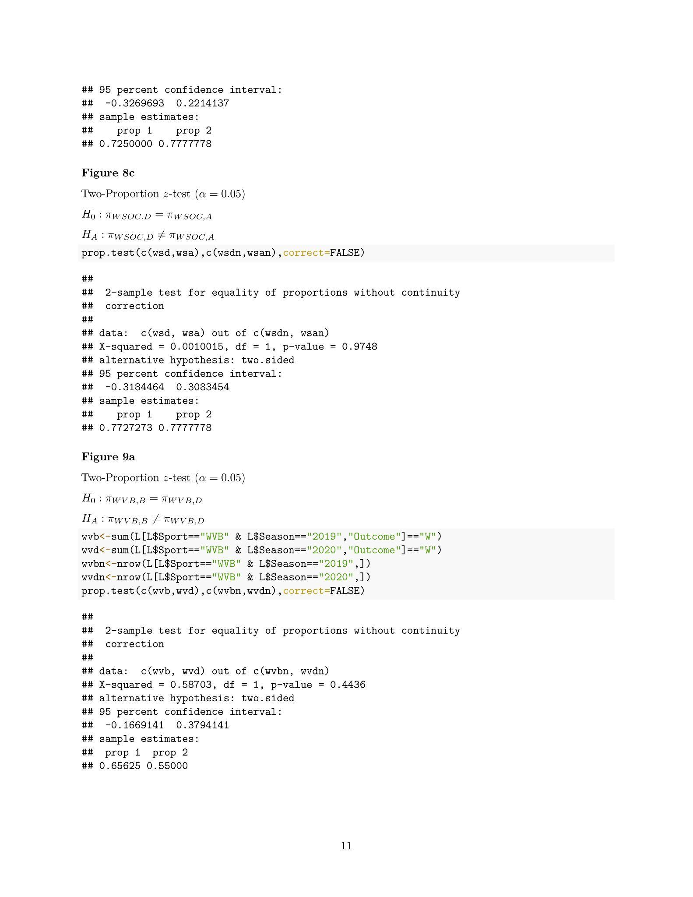
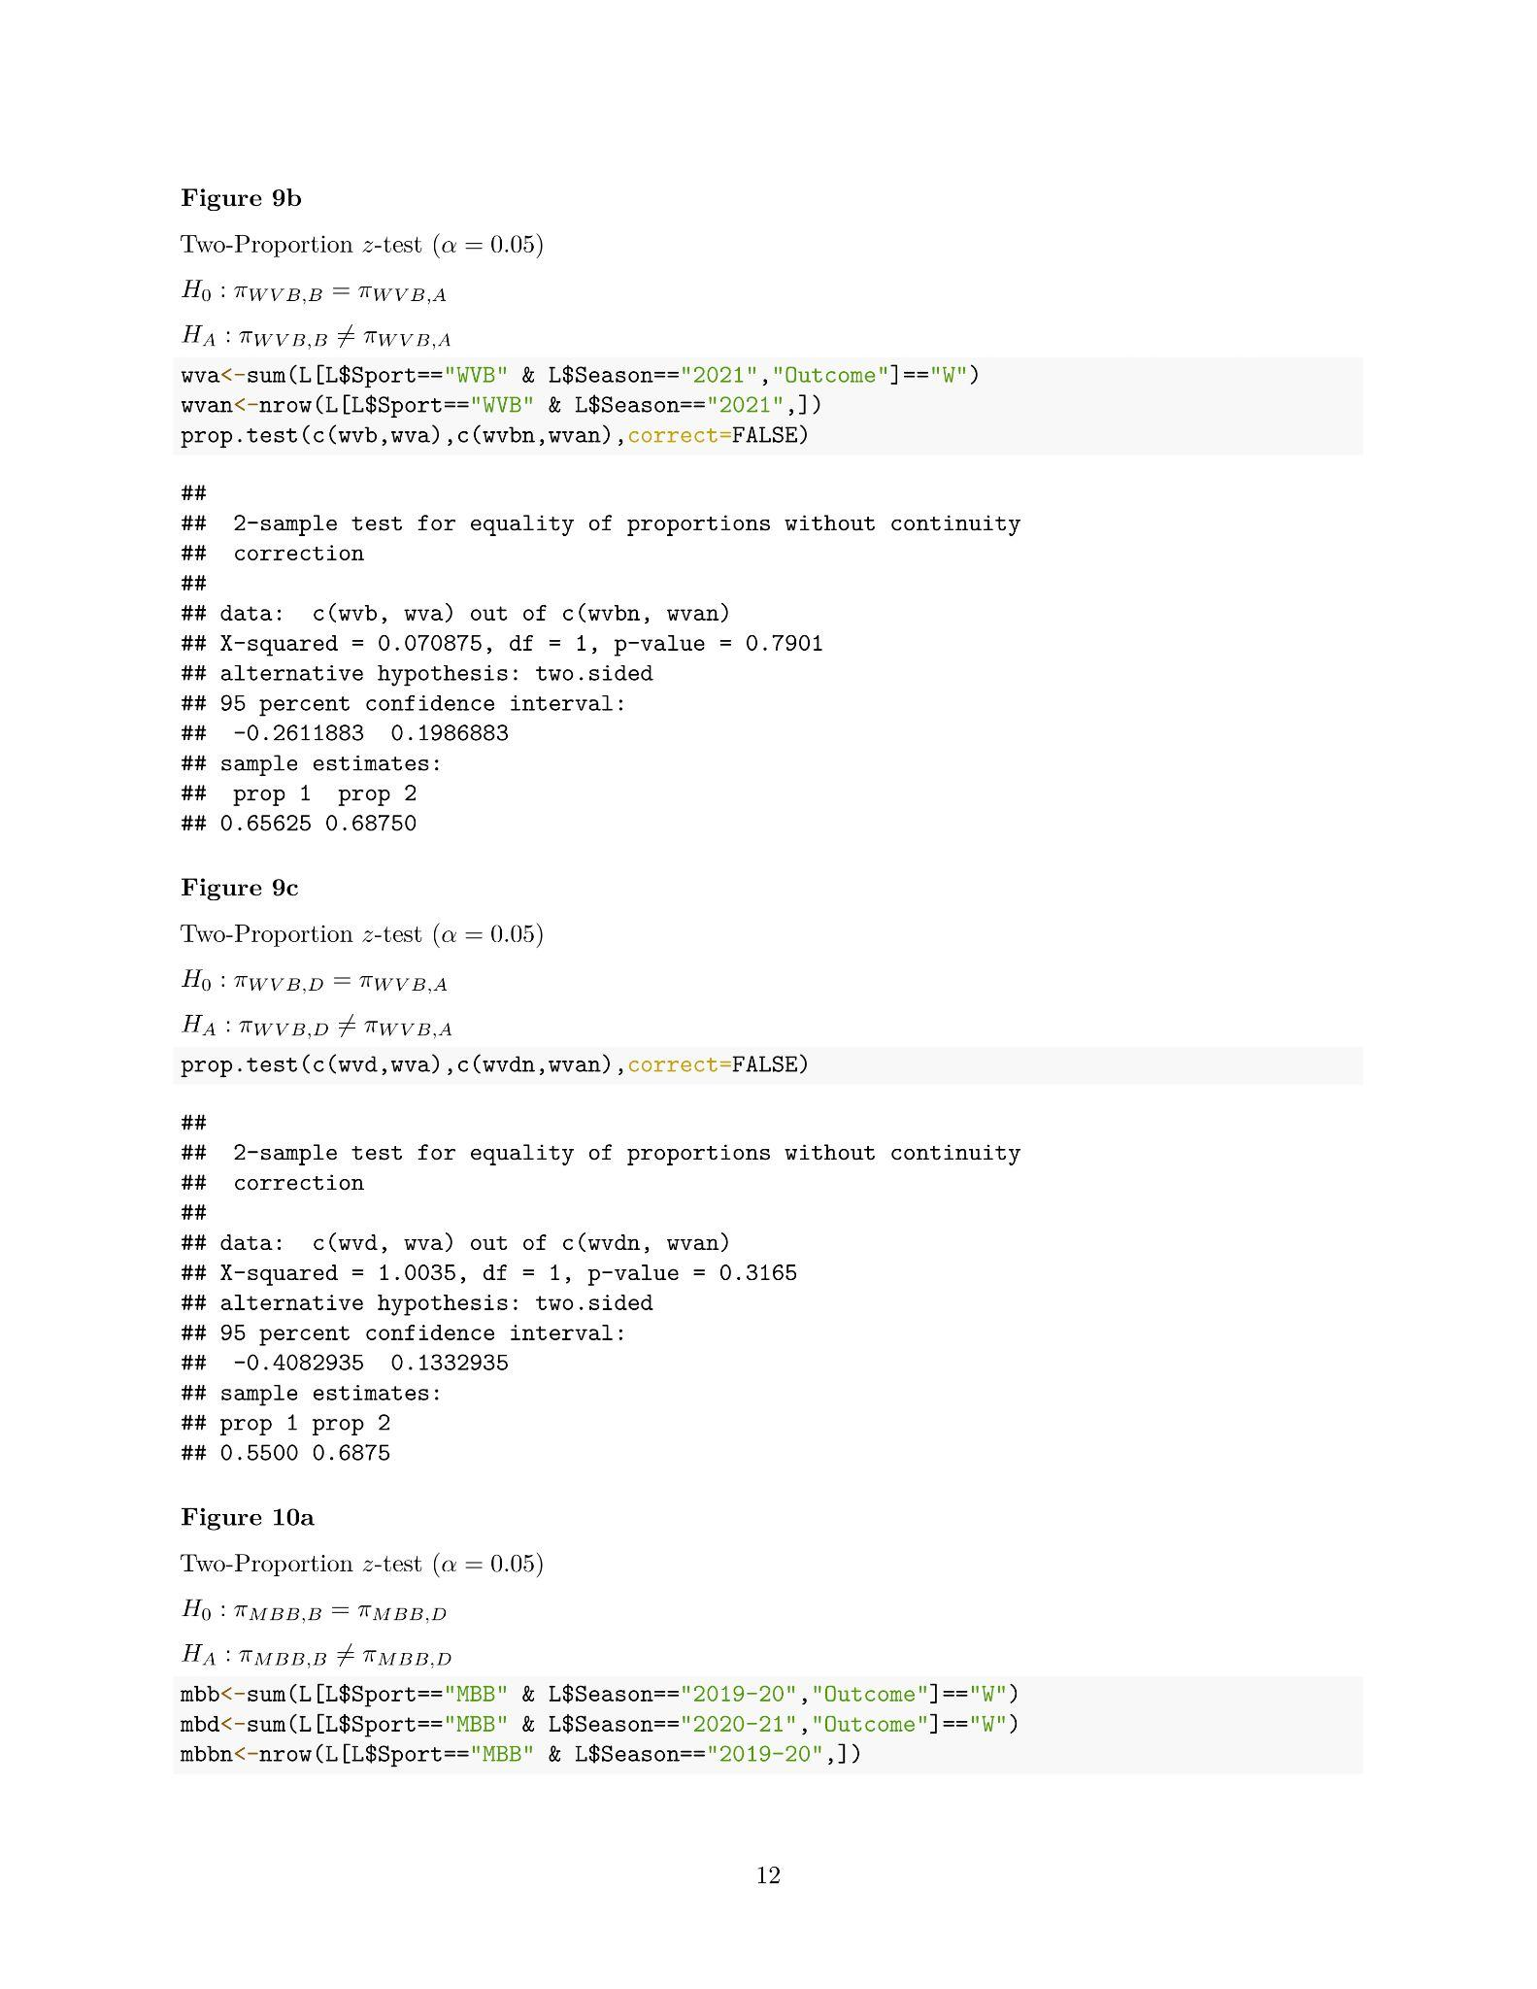
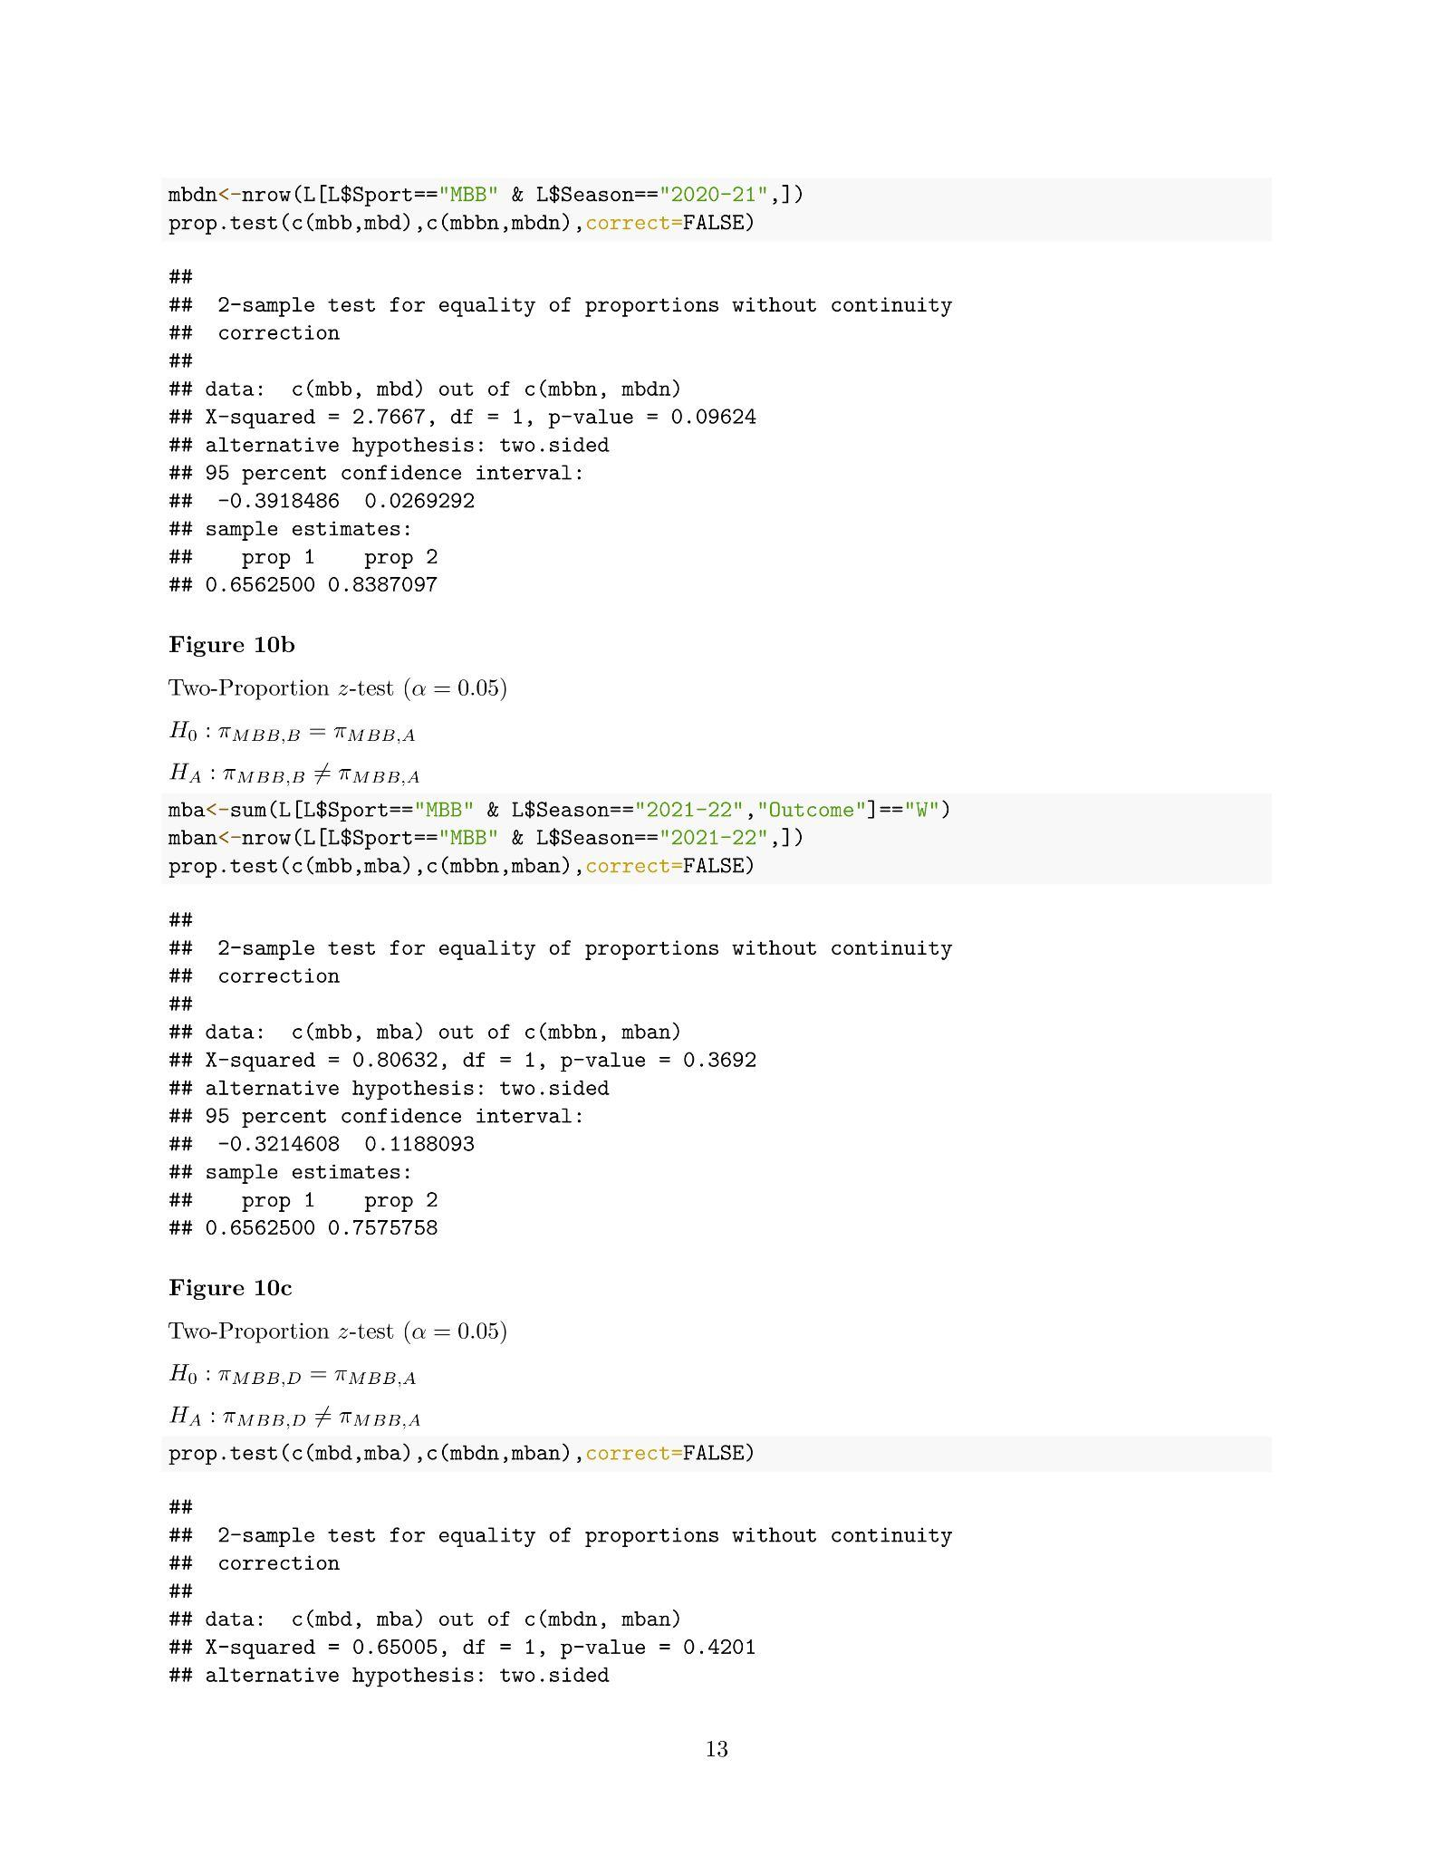
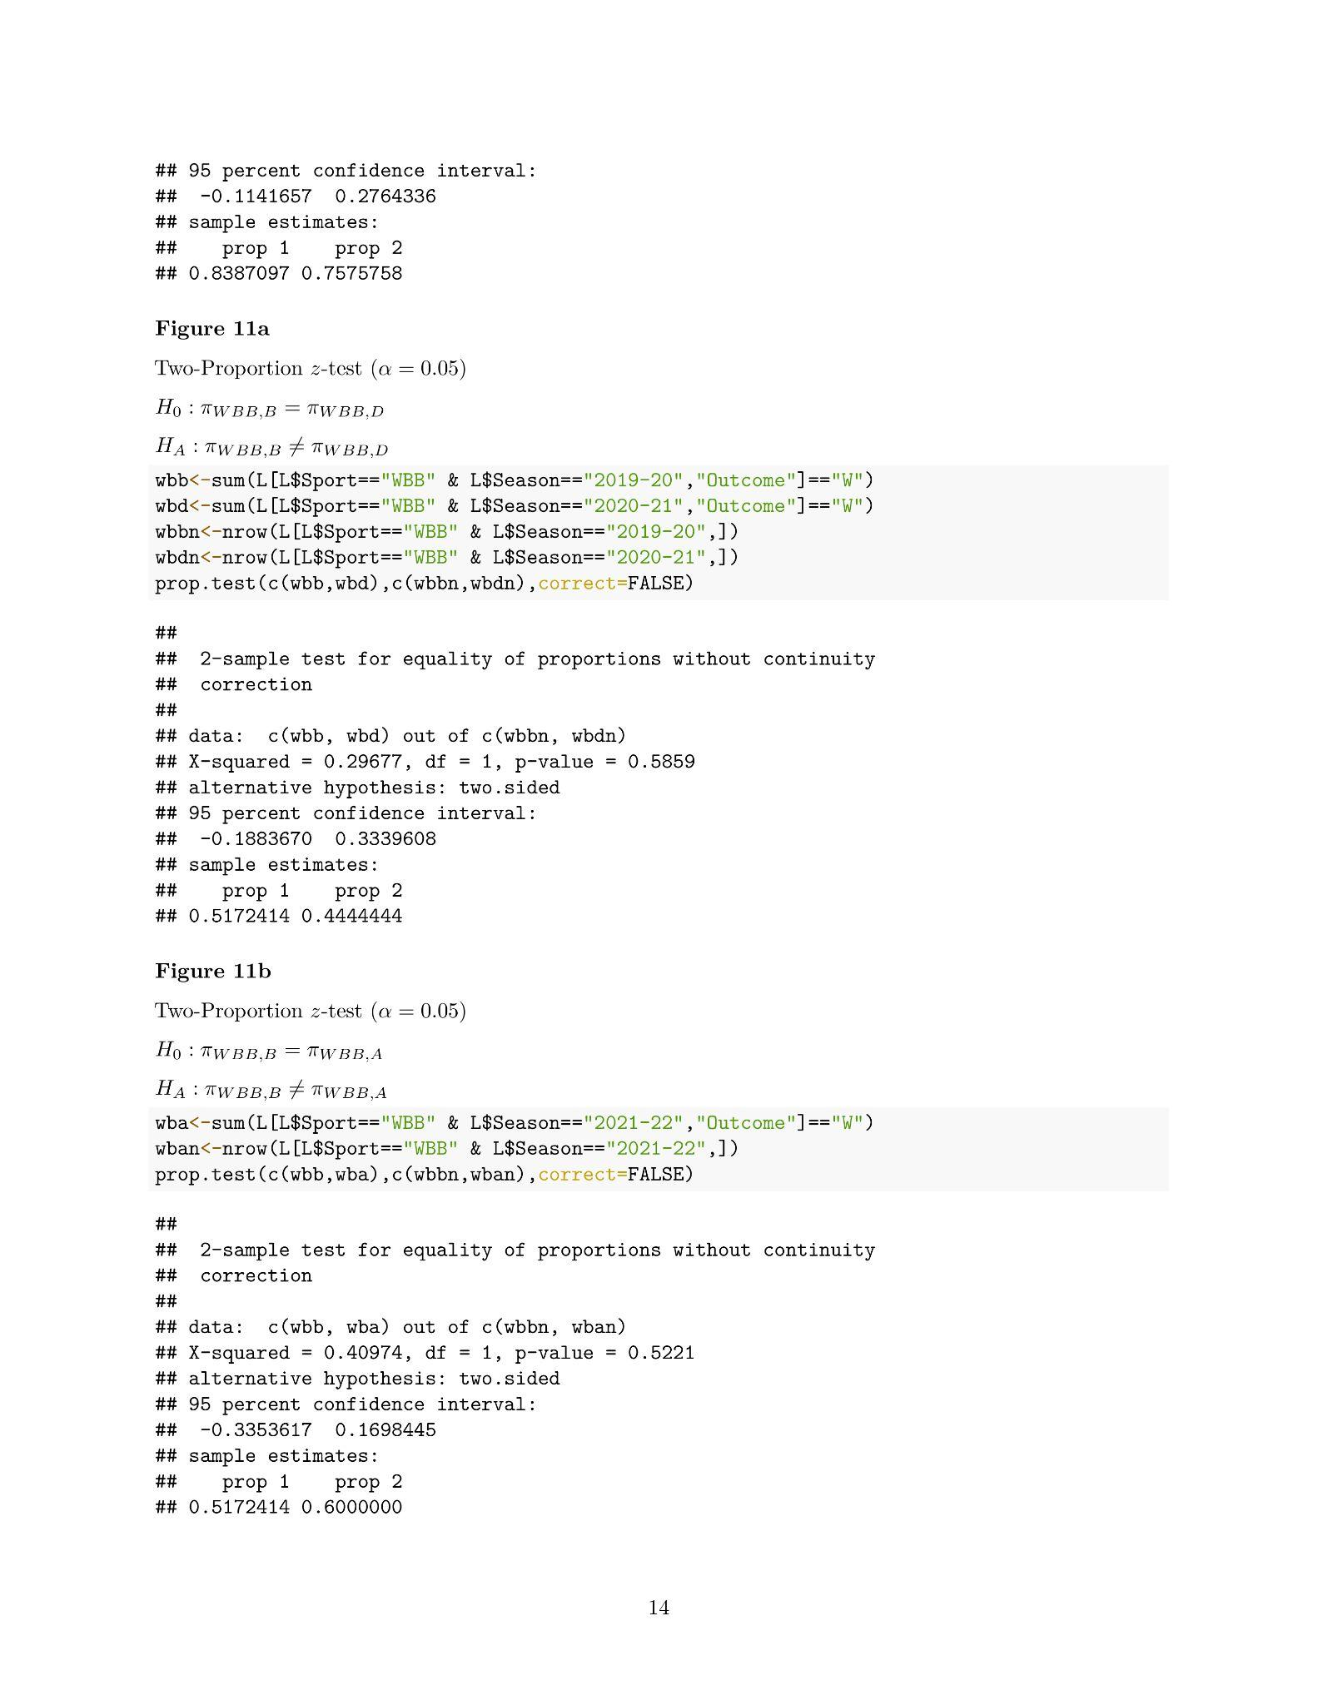
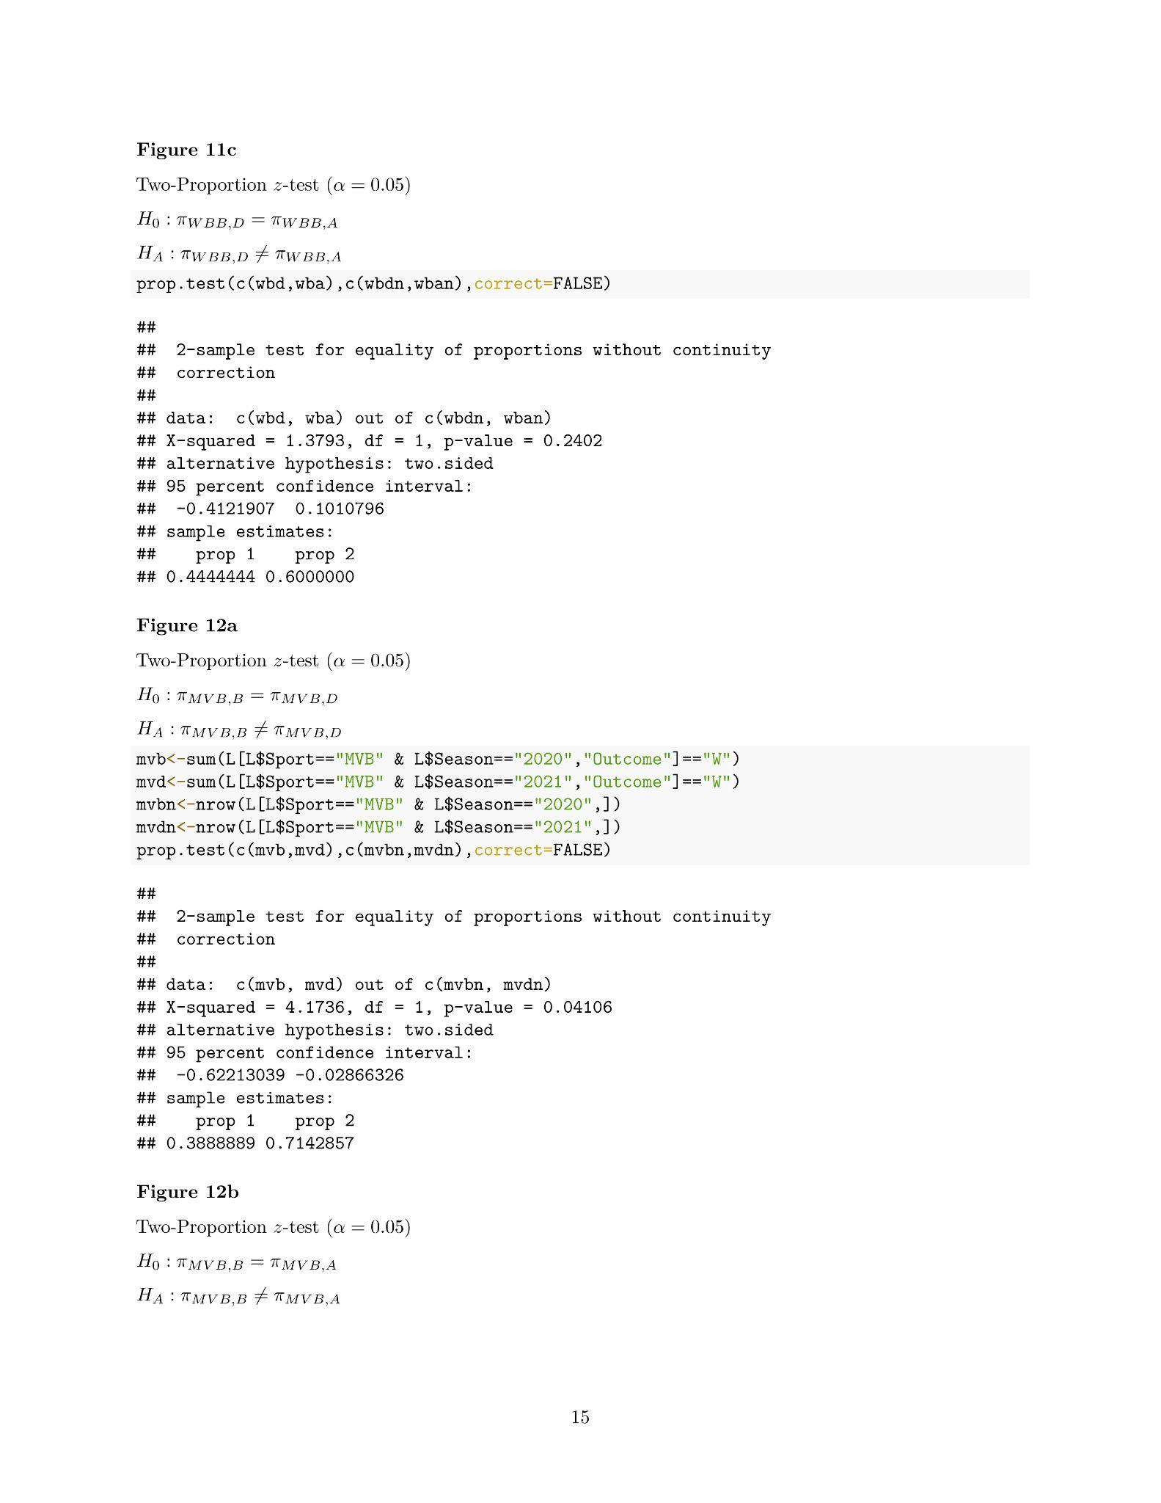
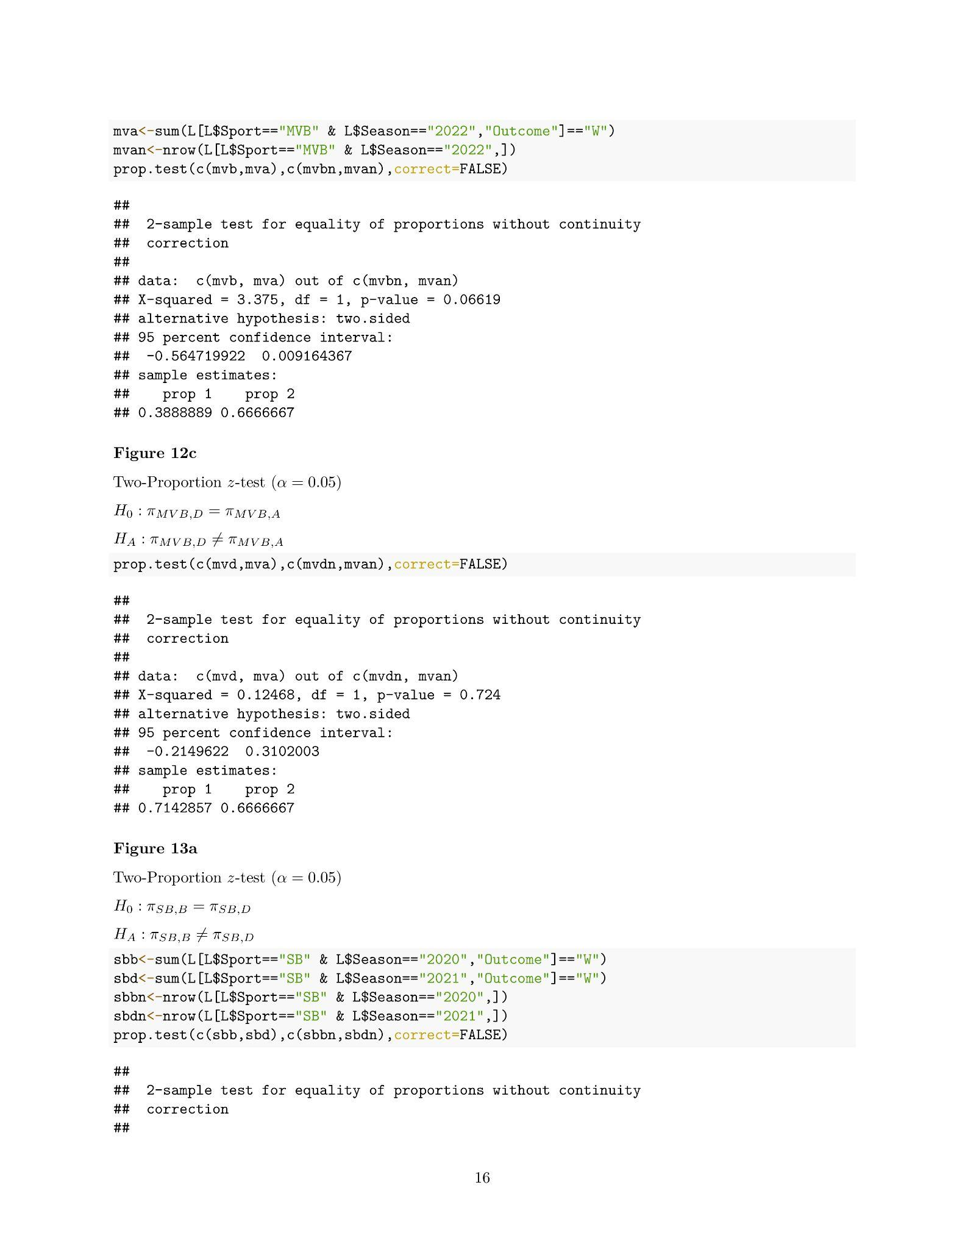
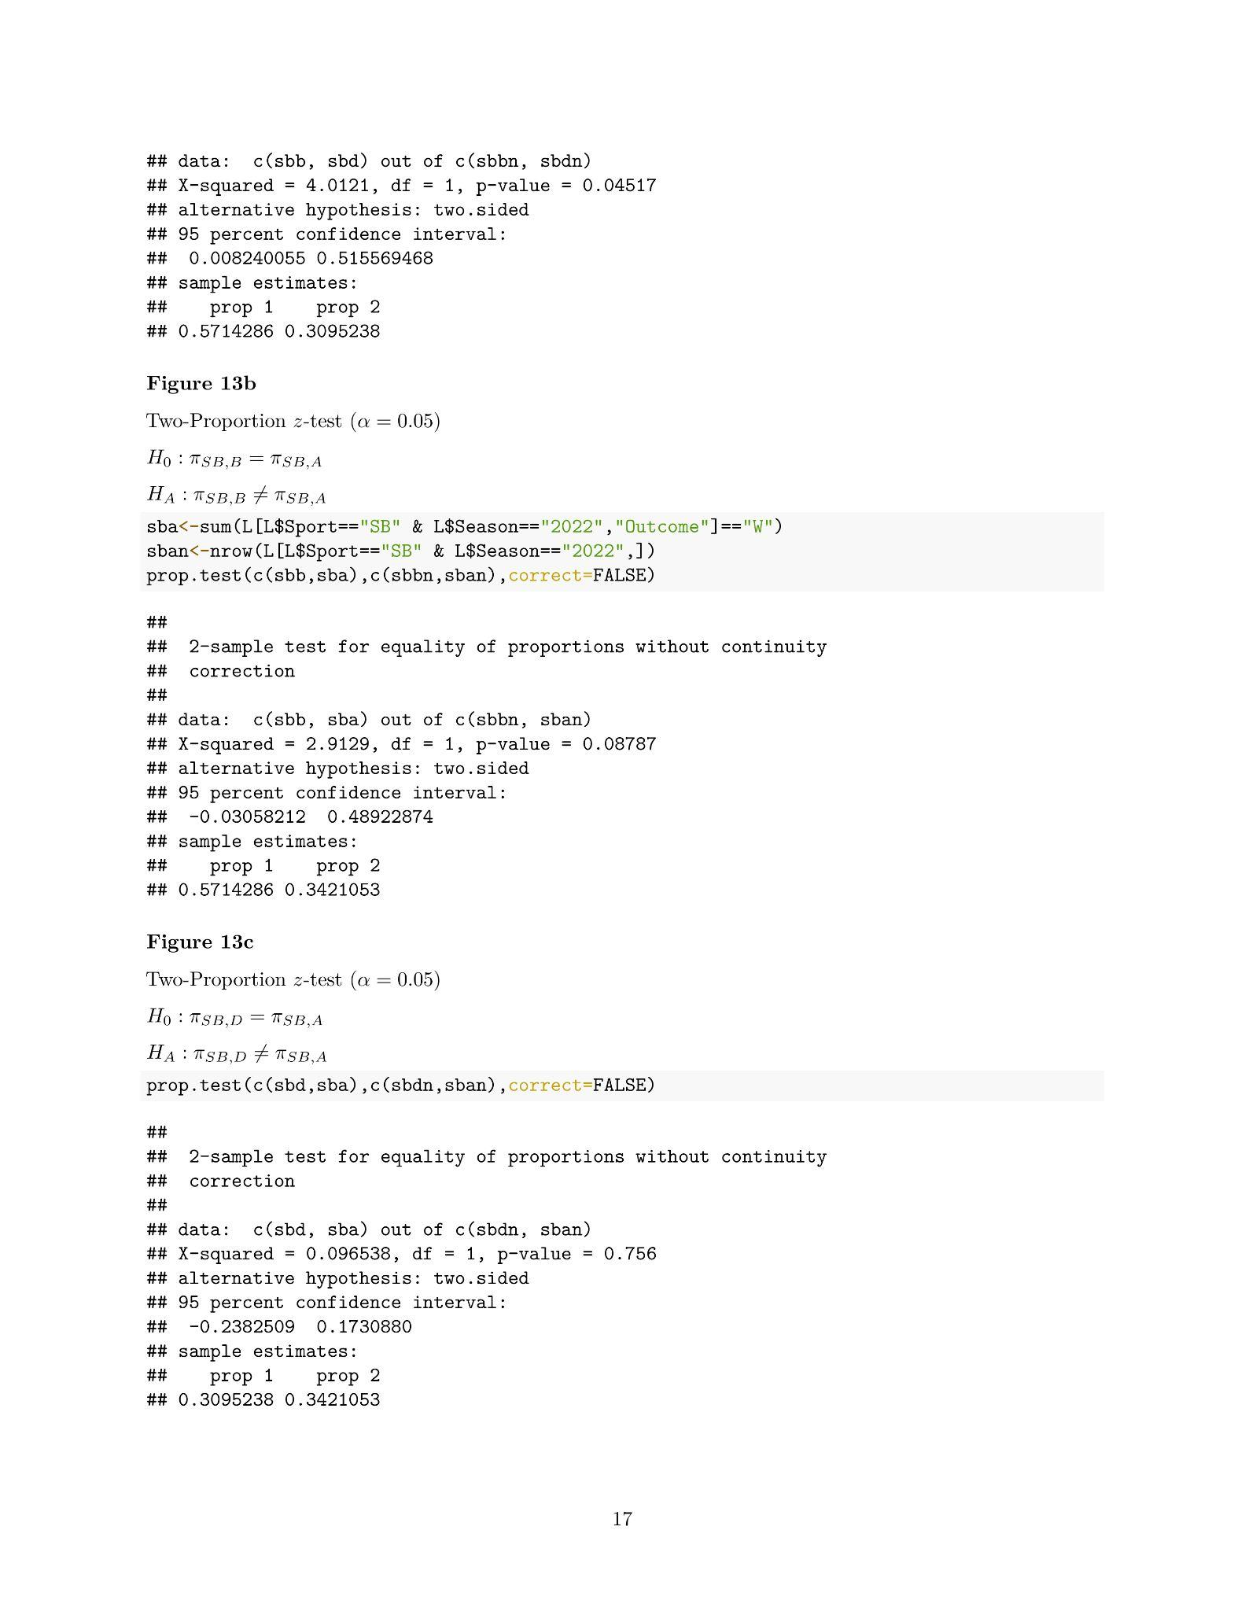
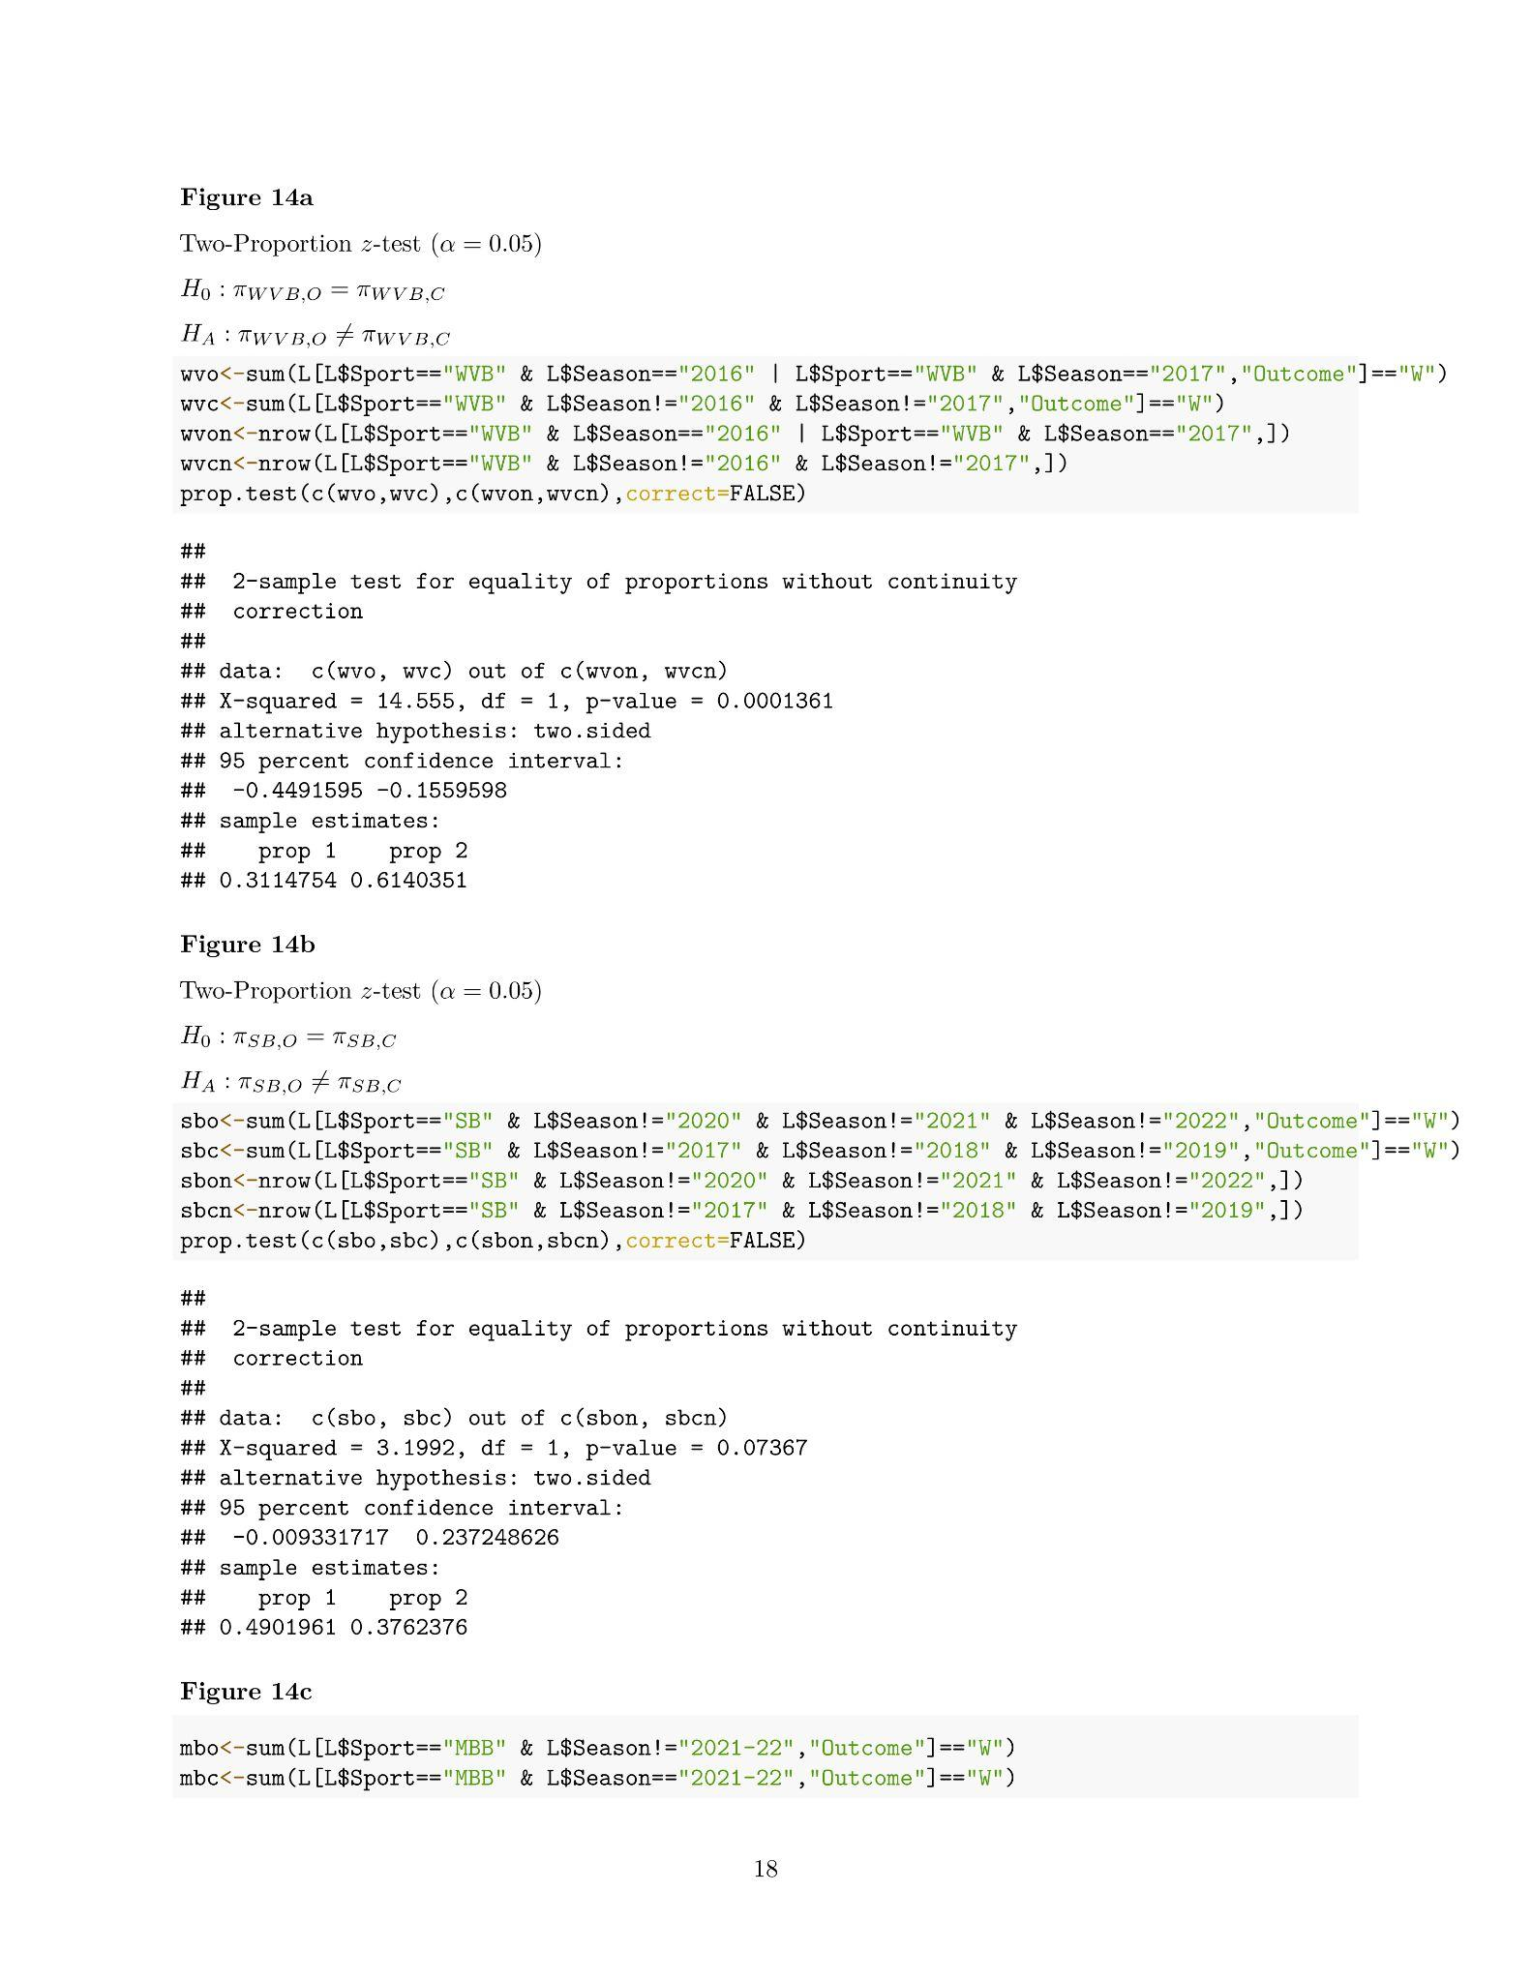
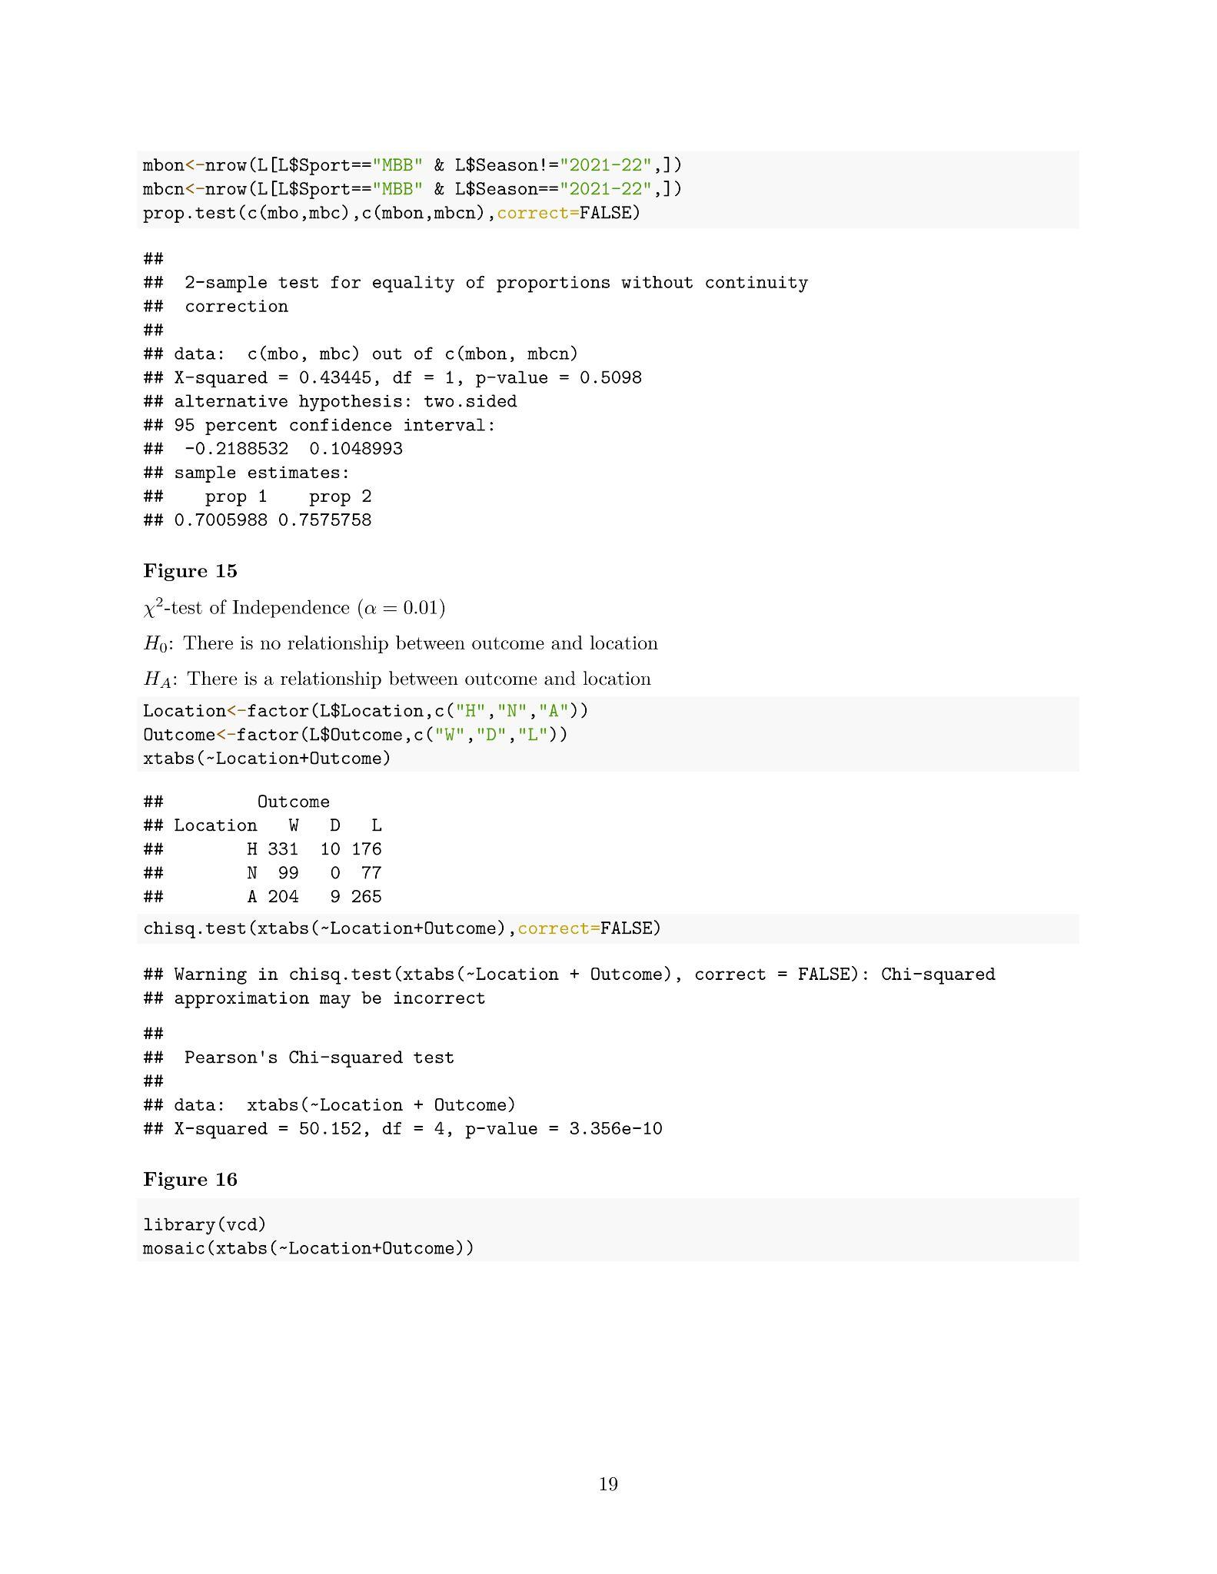
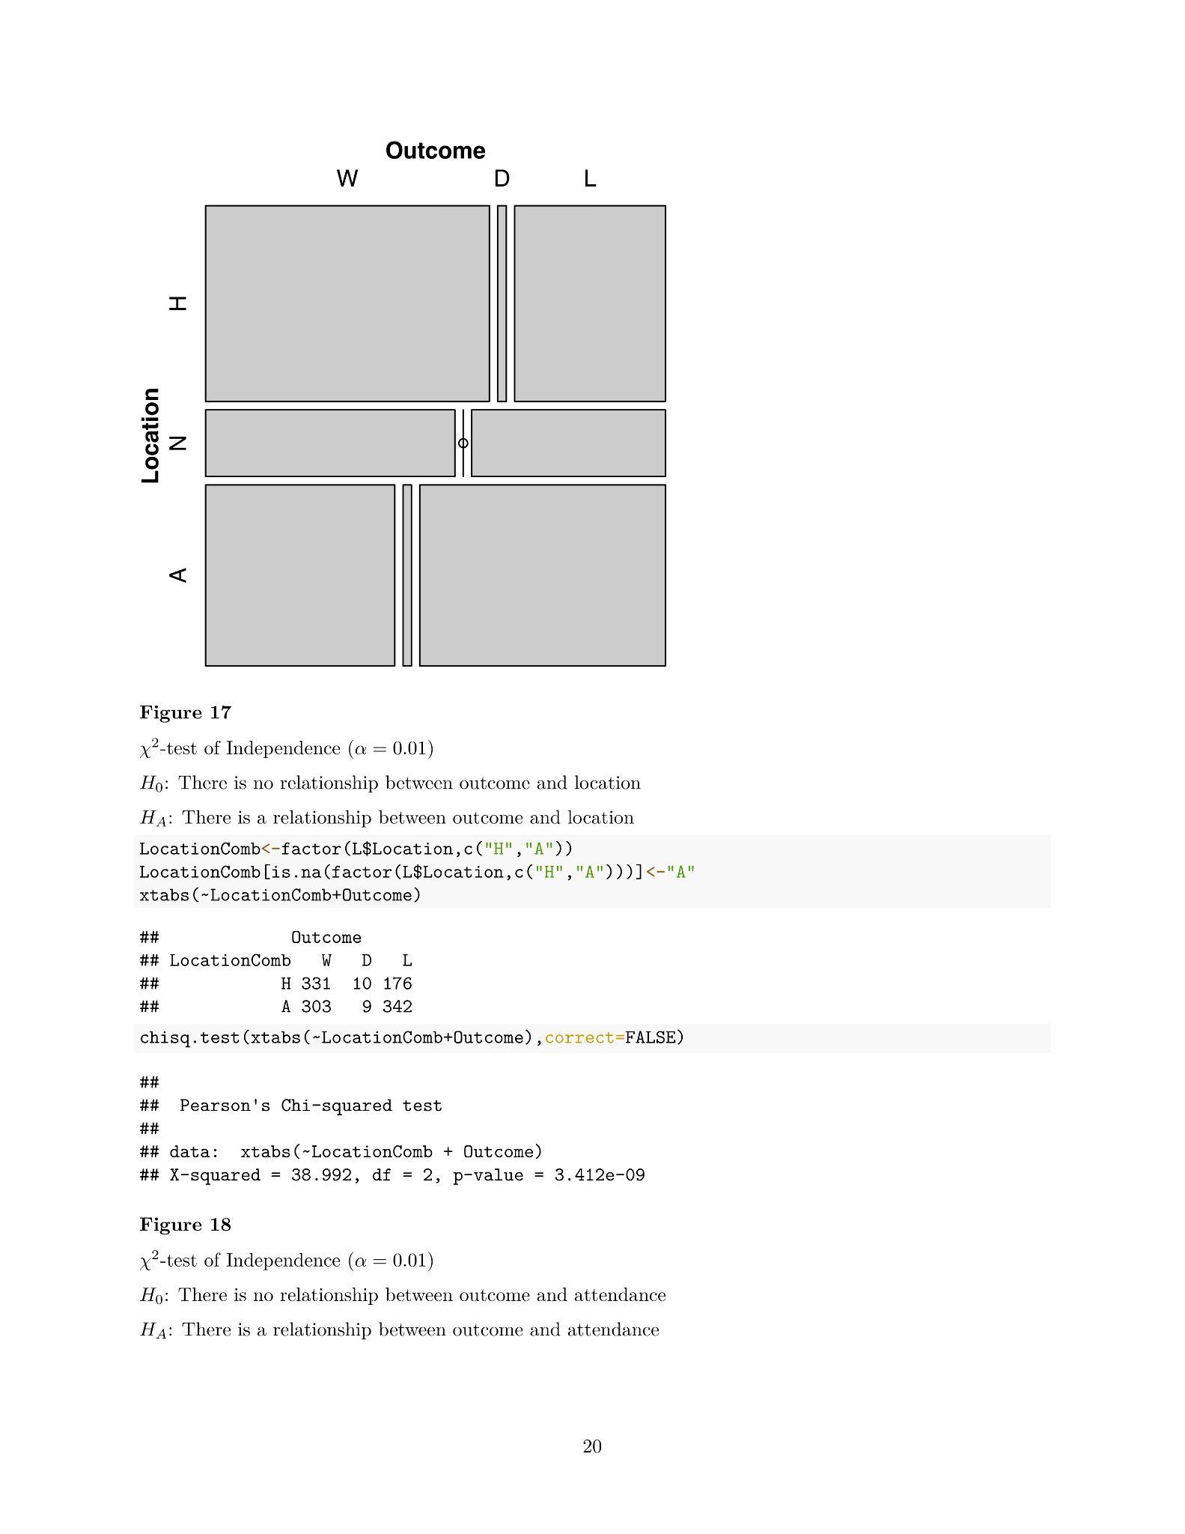
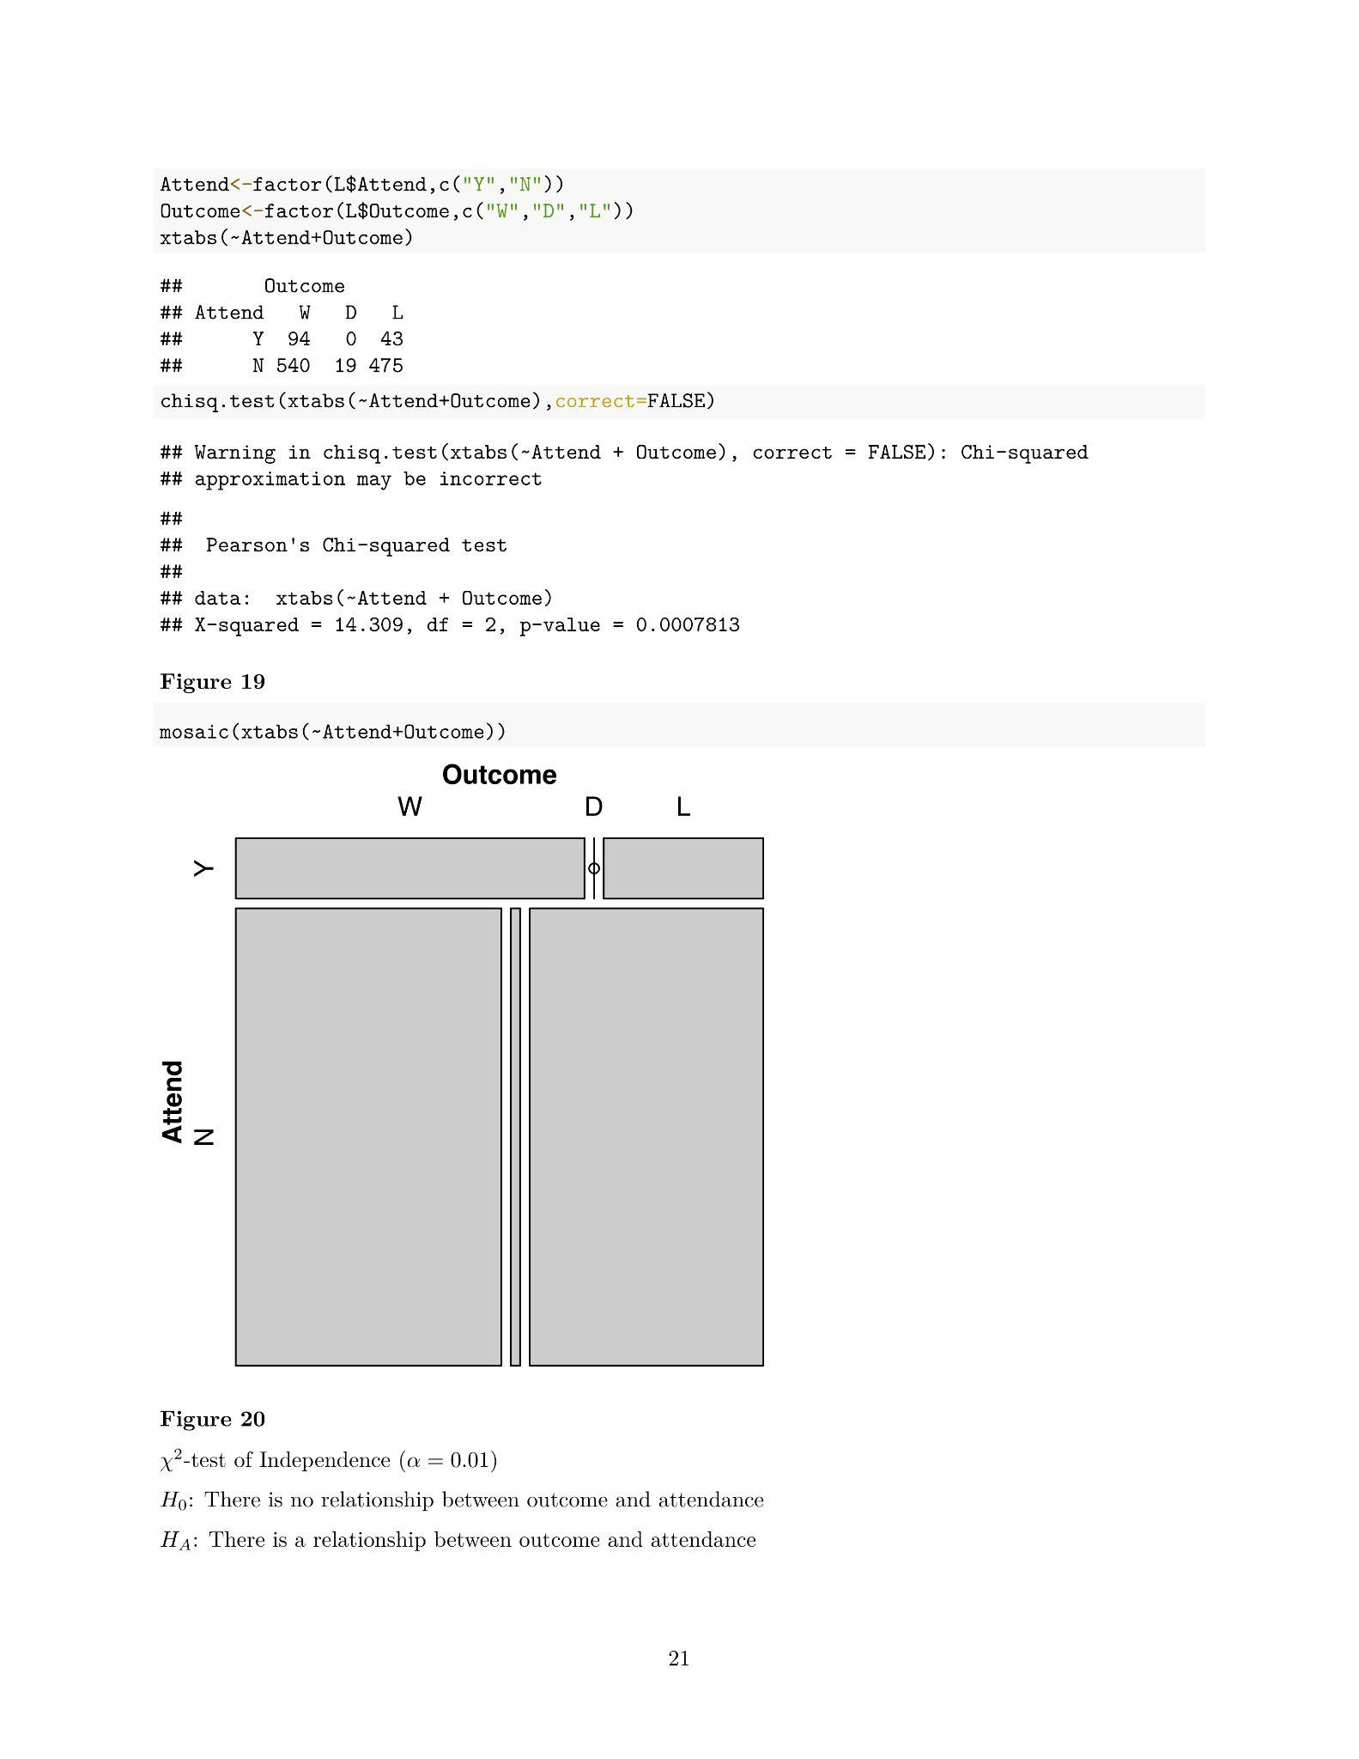
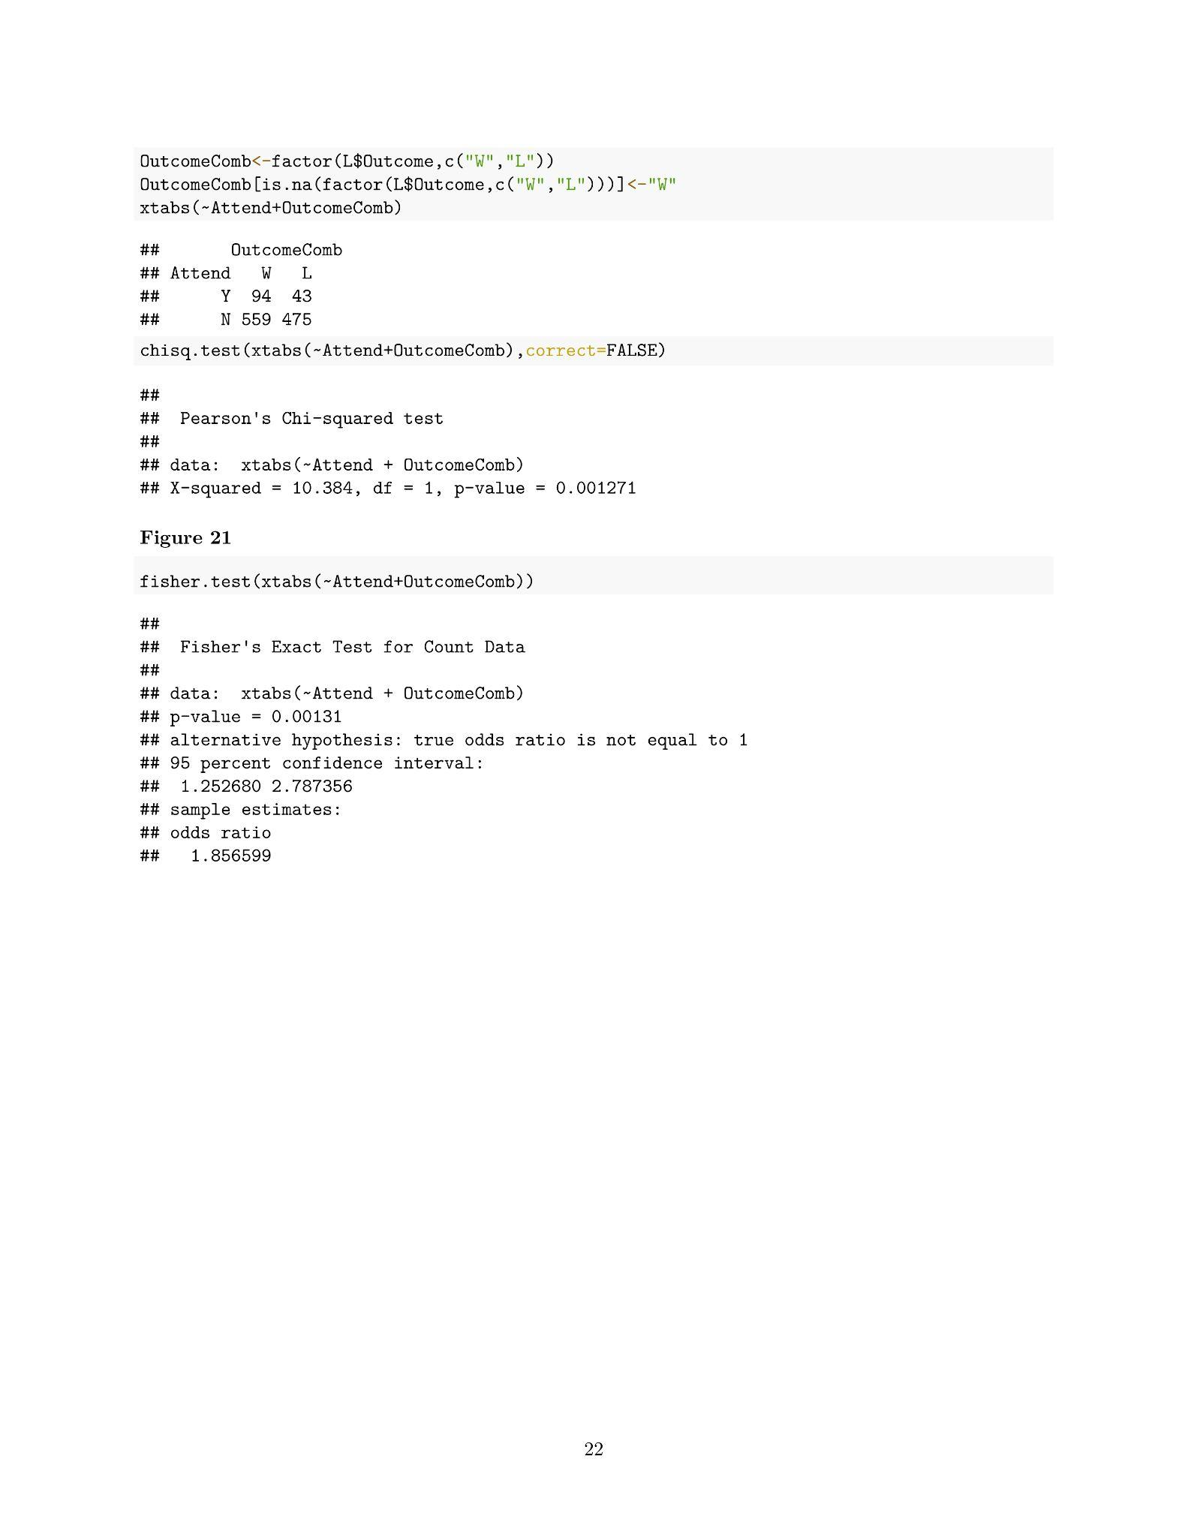
Spring 2022 Project report (3 pages) and Code Appendix (19 pages)

Slide 24
References
LoyolaRamblers.com (and its thousands of subpages)
Other teams’ athletics websites (to verify older matches and conference affiliations)
Wikipedia (to verify conference affiliations)

Slide 25

Questions?

